Slide 1
Engineering @ Cruise

Slide 2
Agenda
Introductions: Why Self-Driving Cars?
AV Vehicles
Ground Truth
Data Infrastructure
Machine Learning Platform
Product Engineering

Slide 3
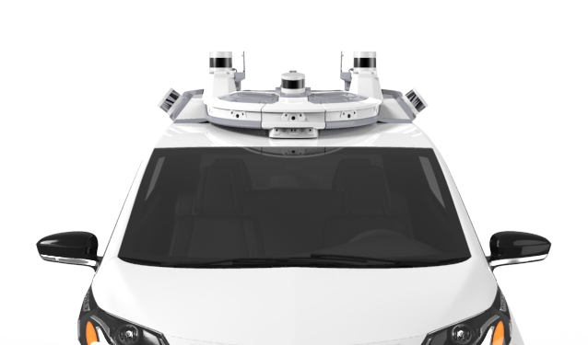
Our Mission
We’re building the world’s most advanced self-driving vehicles to safely connect people with places, things, and experiences they care about.

Slide 4
Cruise Behaviors
Stay safe
Stay focused
Own it
Seek truth
Work together
Be humble

Slide 5
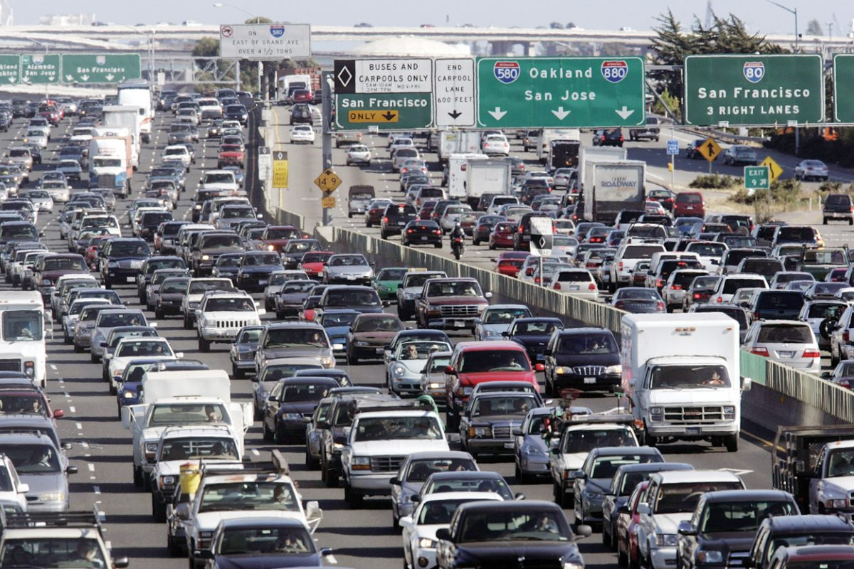
Why Self-Driving Cars?
1.35 million people die each year
Road crashes are leading cause of death for ages 5-29
Passenger vehicles emit 4.6 tons CO2/yr
Americans spend about 293 hrs driving per year → 7 40-hr weeks!
42 hrs sitting in traffic :(
https://www.who.int/news-room/fact-sheets/detail/road-traffic-injuries
https://www.epa.gov/greenvehicles/greenhouse-gas-emissions-typical-passenger-vehicle
https://www.automotive-fleet.com/136735/americans-spend-an-average-of-17-600-minutes-driving-annually
https://bestlifeonline.com/traffic-commute-times/
Notes:
DOUBLE CHECK SOURCES
Road crashes are 9th leading cause of death globally
~1.3 million deaths a year globally
3,287 deaths a day (five 747s worth). 100 a day in the US alone
Why is this acceptable? With self driving cars, this could be 0!
people spend a lot of time driving that could be spent doing other things
Less time spent commuting
Less need for parking
Higher utilization per car -> less cars
One of the first majorly society-impacting applications of robotics!
like the apollo program for our generation
Opens up a bunch of possibilities of how we can interact with our technology

Slide 6
Why Self-Driving Cars?
Less human error: greater safety
Lower carbon emissions
Save driving time!
Fewer cars for more people
Less need for parking

Slide 7

Cruise Vehicle History
GM Cruise Confidential

Slide 8
About Me
Hardware reliability engineer
I interned at Cruise!
Been at Cruise ~7 months
Graduated with Mech E degree from University of California, Davis in 2018
Love cars, love bikes, love going fast
Austin Harris

Slide 9
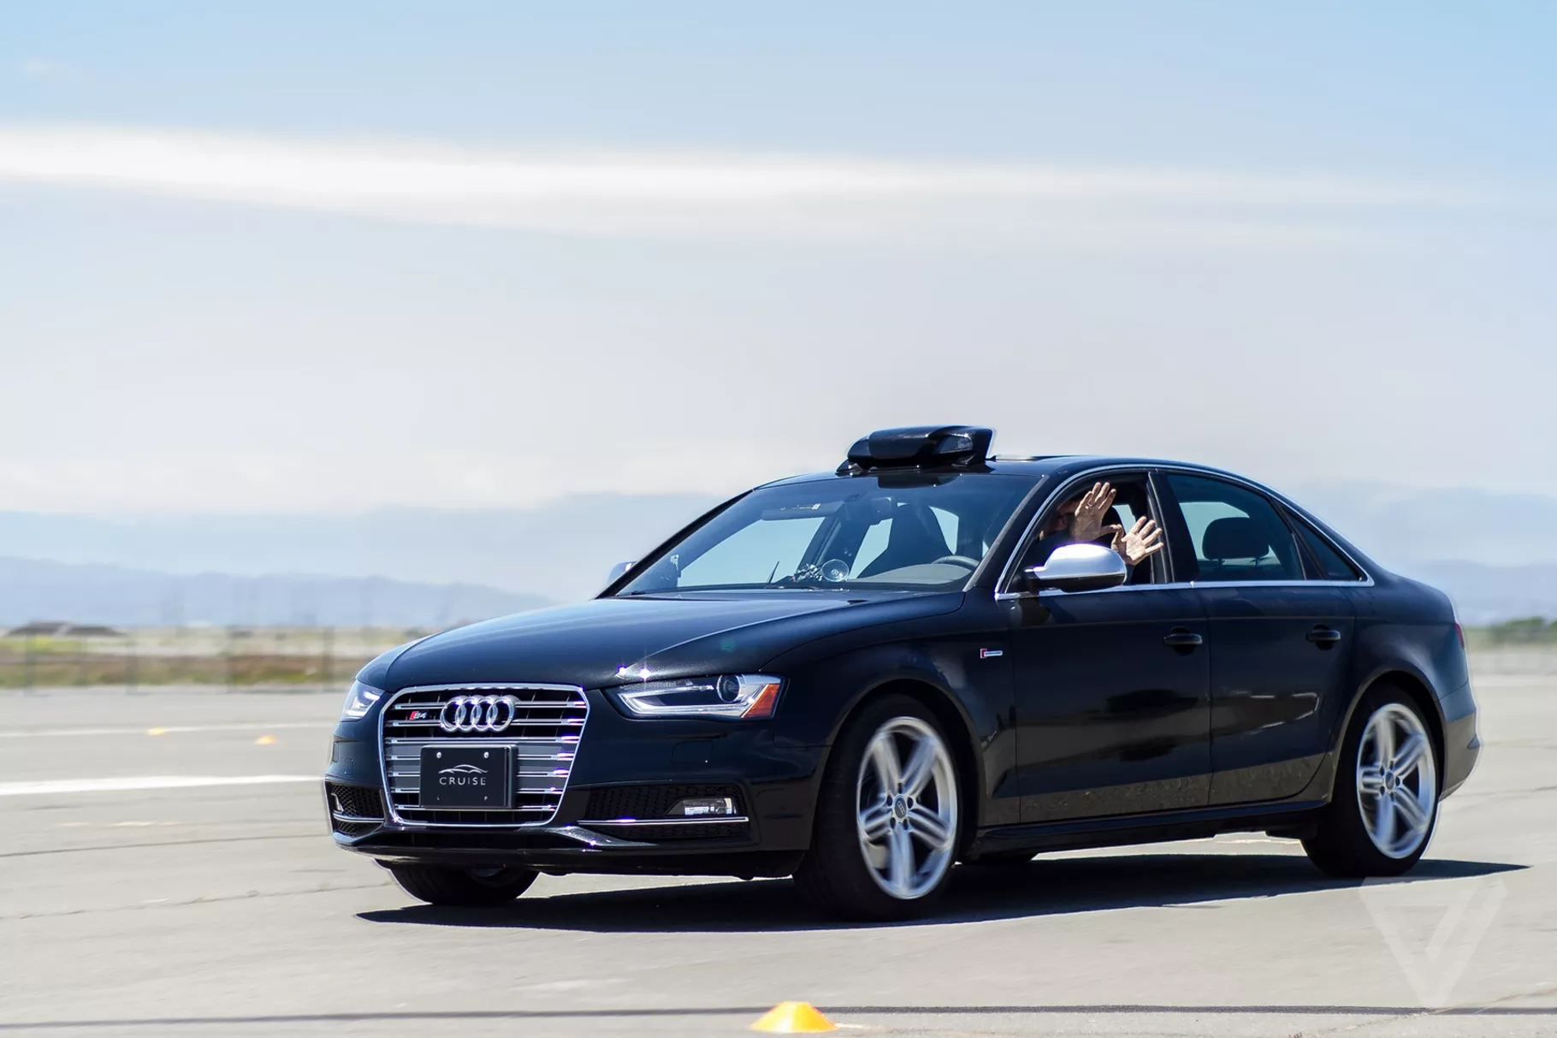
Audi S4
Retrofitted 2x Audi S4’s with RP-1
GM Cruise Confidential

Slide 10
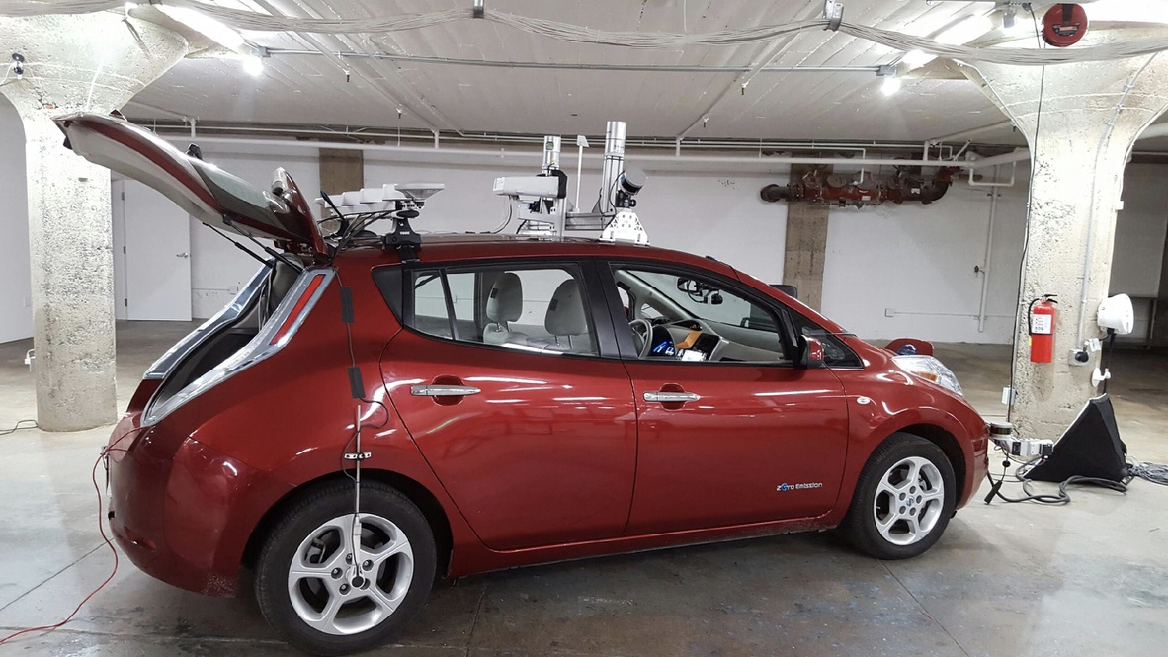
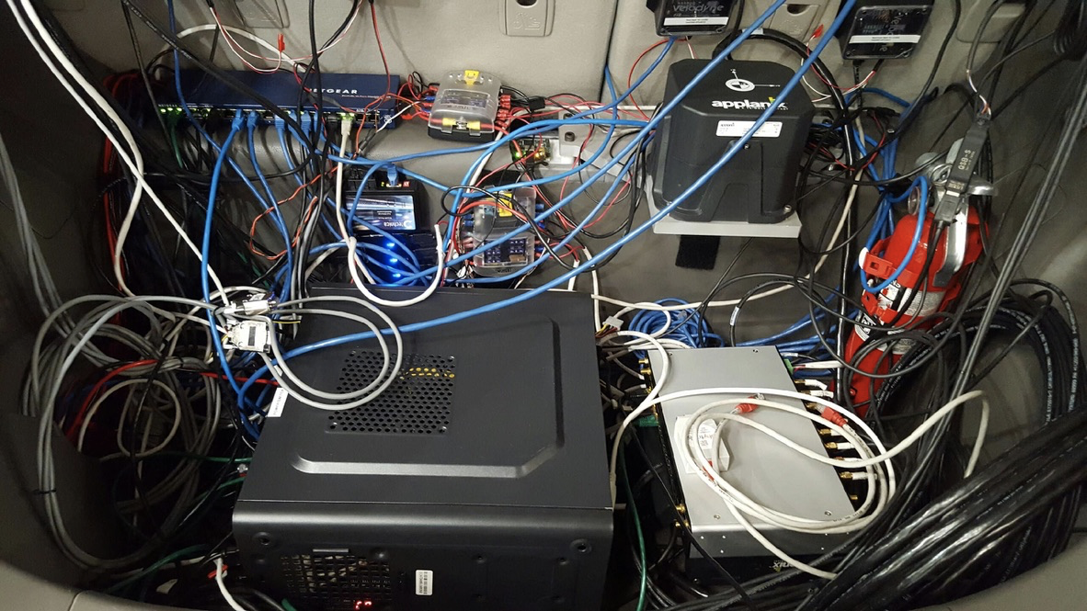
Nissan Leaf
Retrofitted 5x Nissan Leafs working towards fully autonomous system
GM Cruise Confidential

Slide 11
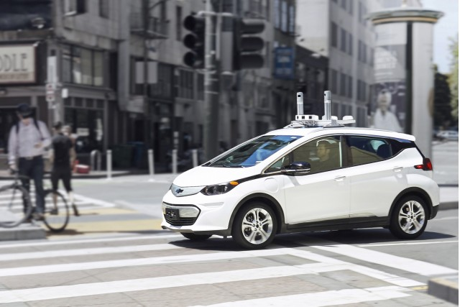
Track 1
Retrofitted Chevy Bolts with fully autonomous system
GM Cruise Confidential

Slide 12
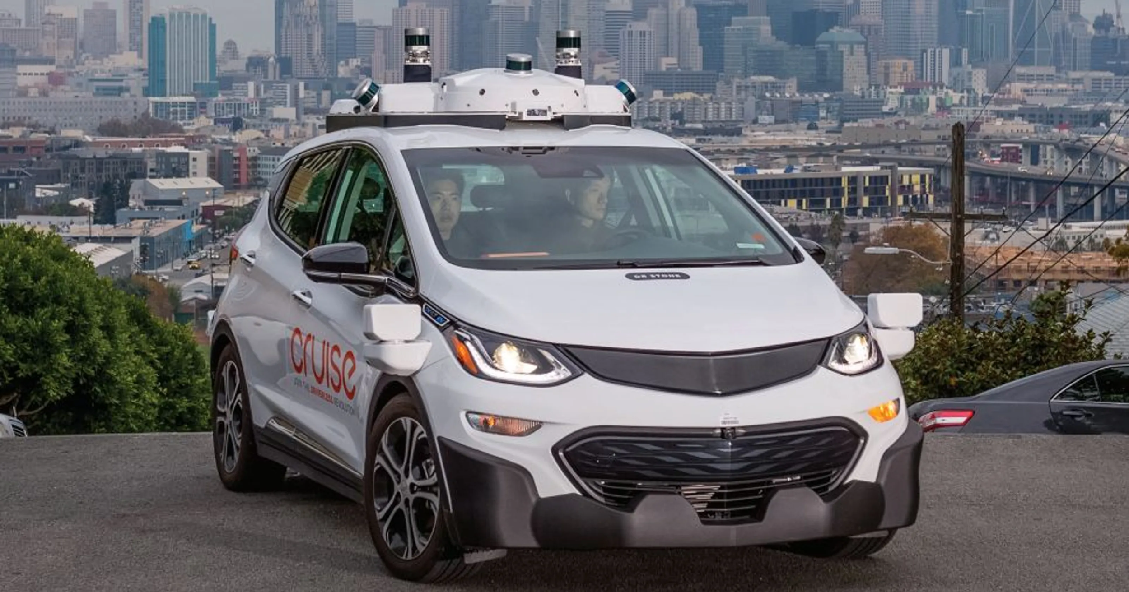
Track 2
Retrofitted Bolts (with some changes) with fully autonomous system
Vehicles assembled by GM
GM Cruise Confidential

Slide 13
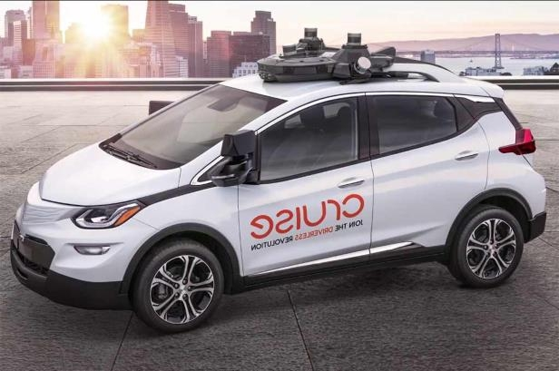
Track 3
Custom designed Bolt with deeply integrated autonomous system and redundant systems
GM Cruise Confidential

Slide 14
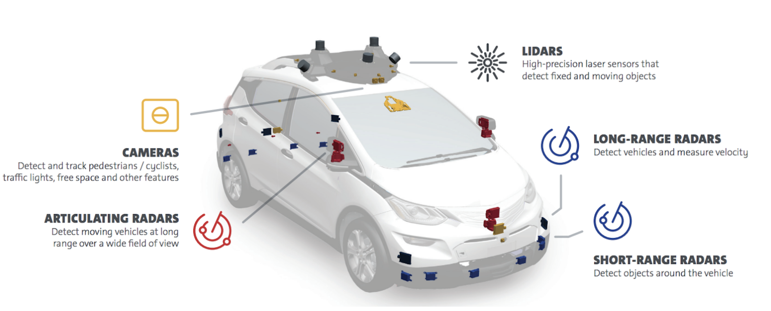
T3 Systems Overview

Slide 15
What does the Vehicles team do?
Hardware Reliability Team
Fleet availability
Fleet reliability
Drive product improvements
Examples
Develop technician documentation
Root cause hardware issues
Develop emergency response processes
Take findings from root cause analysis and drive product requirements/improvements to GM
Calibration & Development Team
Develop & test sensor calibration scripts
Develop & test hardware required for calibrations
Vehicle bring-up development
Examples
Improve reliability of lidar calibration script
Test & improve calibration scenes for object cameras
Define bring-up processes to hand off to GM

Slide 16
Fun Fact
How much power does our autonomous driving computer consume?
Notes:
Answer: up to 4.4 kW or roughly 6 horsepower

Slide 17
Ground Truth

Slide 18
Groups at Cruise (Engineering)
AV Platform
Building the nerves and muscles of the AV
Ground Truth
Enable our AVs to understand the world
Core Infrastructure
Mapping
Deploy highly scalable systems
Enable our AVs to navigate the world
Data Infrastructure
Enable insights from our extensive data collection
ML Platform
Unlock ML development efficiency to accelerate our development
Data Science
Use our diverse data to improve business and engineering decisions
Product Engineering
Launch the world’s best AV ridesharing service
Engineering Productivity
Build a world-class development environment at Cruise
Remote Assistance
Ensure we are always able to get the AV unstuck

Slide 19
Groups at Cruise (Engineering)
AV Platform
Building the nerves and muscles of the AV
Ground Truth
Enable our AVs to understand the world
Core Infrastructure
Deploy highly scalable systems
Mapping
Enable our AVs to navigate the world
Data Infrastructure
Enable insights from our extensive data collection
ML Platform
Unlock ML development efficiency to accelerate our development
Data Science
Use our diverse data to improve business and engineering decisions
Product Engineering
Launch the world’s best AV ridesharing service
Engineering Productivity
Build a world-class development environment at Cruise
Remote Assistance
Ensure we are always able to get the AV unstuck

Slide 20
About Me
Full-Stack Software Engineer
Ground Truth Engineering team
Been at Cruise for < 1.5 years
Graduated UC Berkeley in 2015
San Francisco Bay Area native, but familiar with the Toronto area/GTA
Victoria Lo
Notes:
Full stack, but mostly front end tbh
Cruise grown from ~450-1300 or so

Slide 21
Ground Truth provides labeled data.
How do cars know what they are seeing?
How do machine learning models know what the “right” answer is?
How do tests/QA know how to evaluate the car code?
How does data science know what decisions to make?
How do we know how well we are driving?

Slide 22
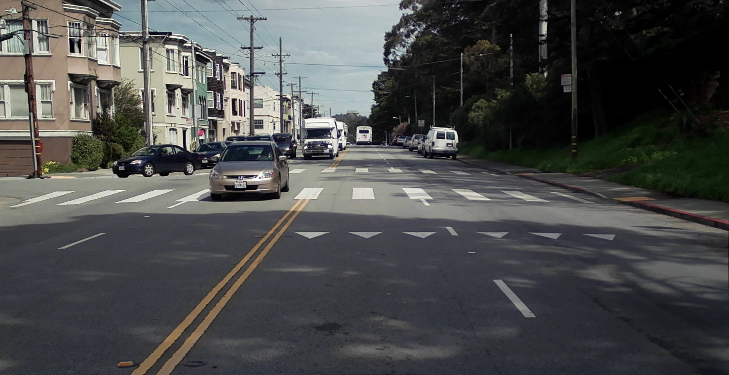
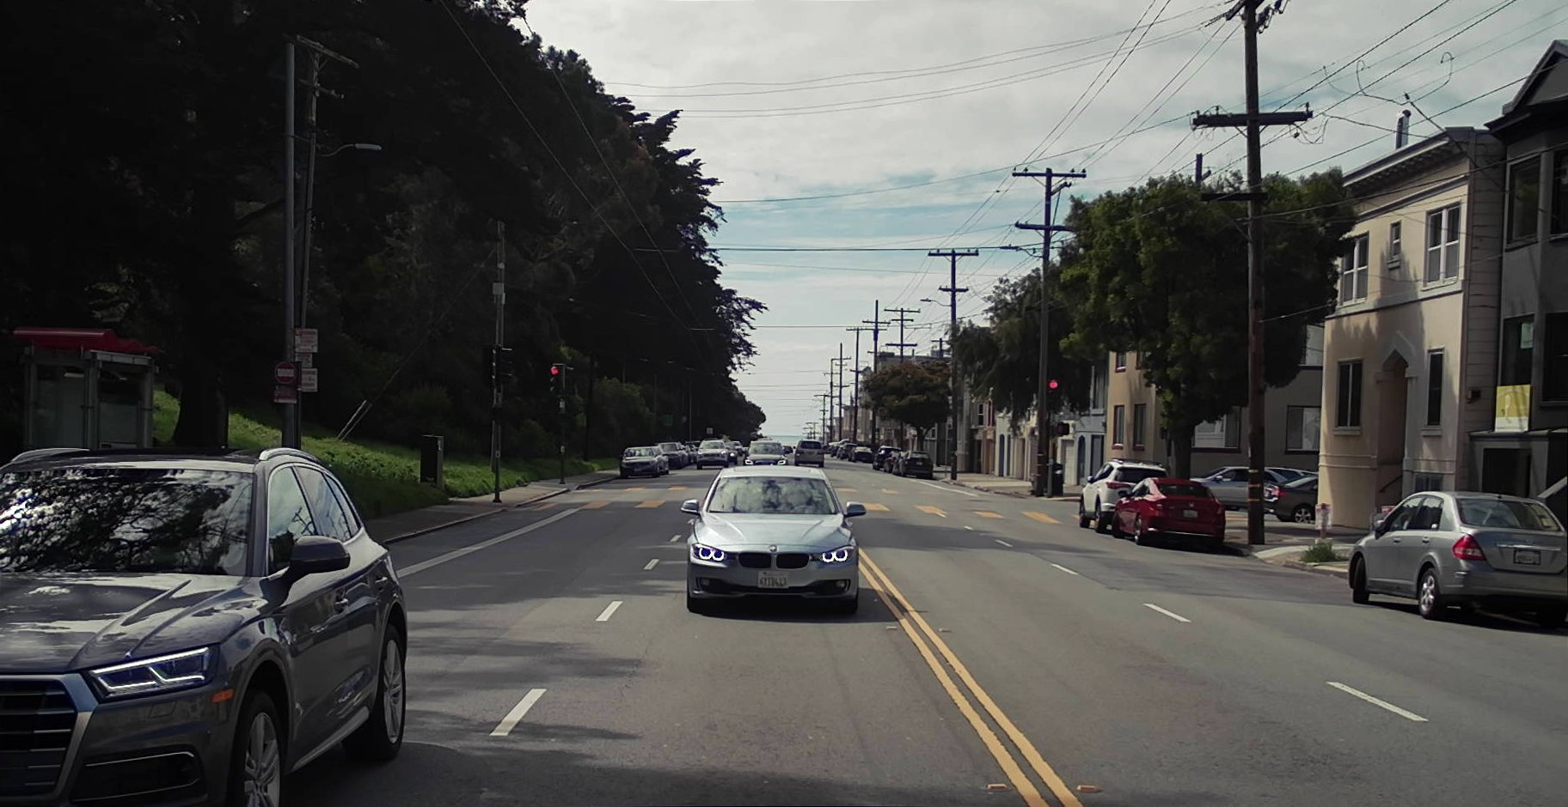
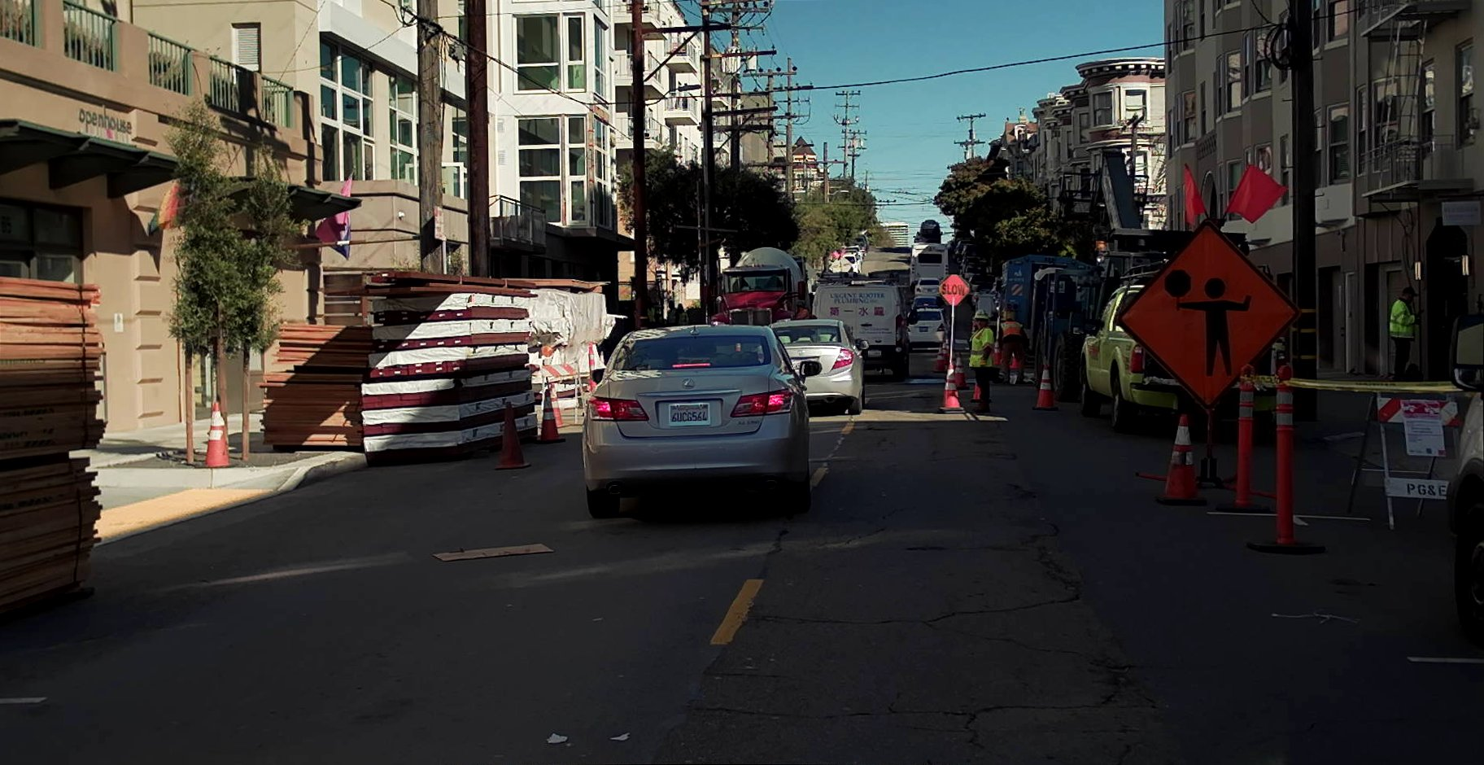
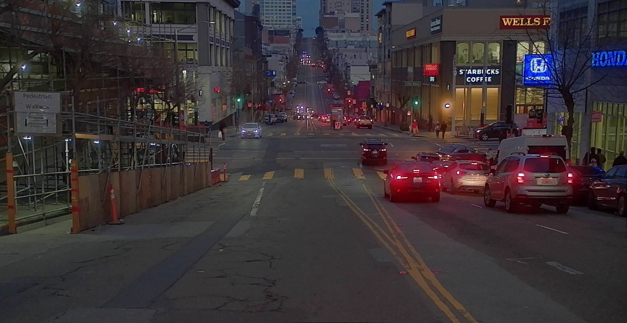
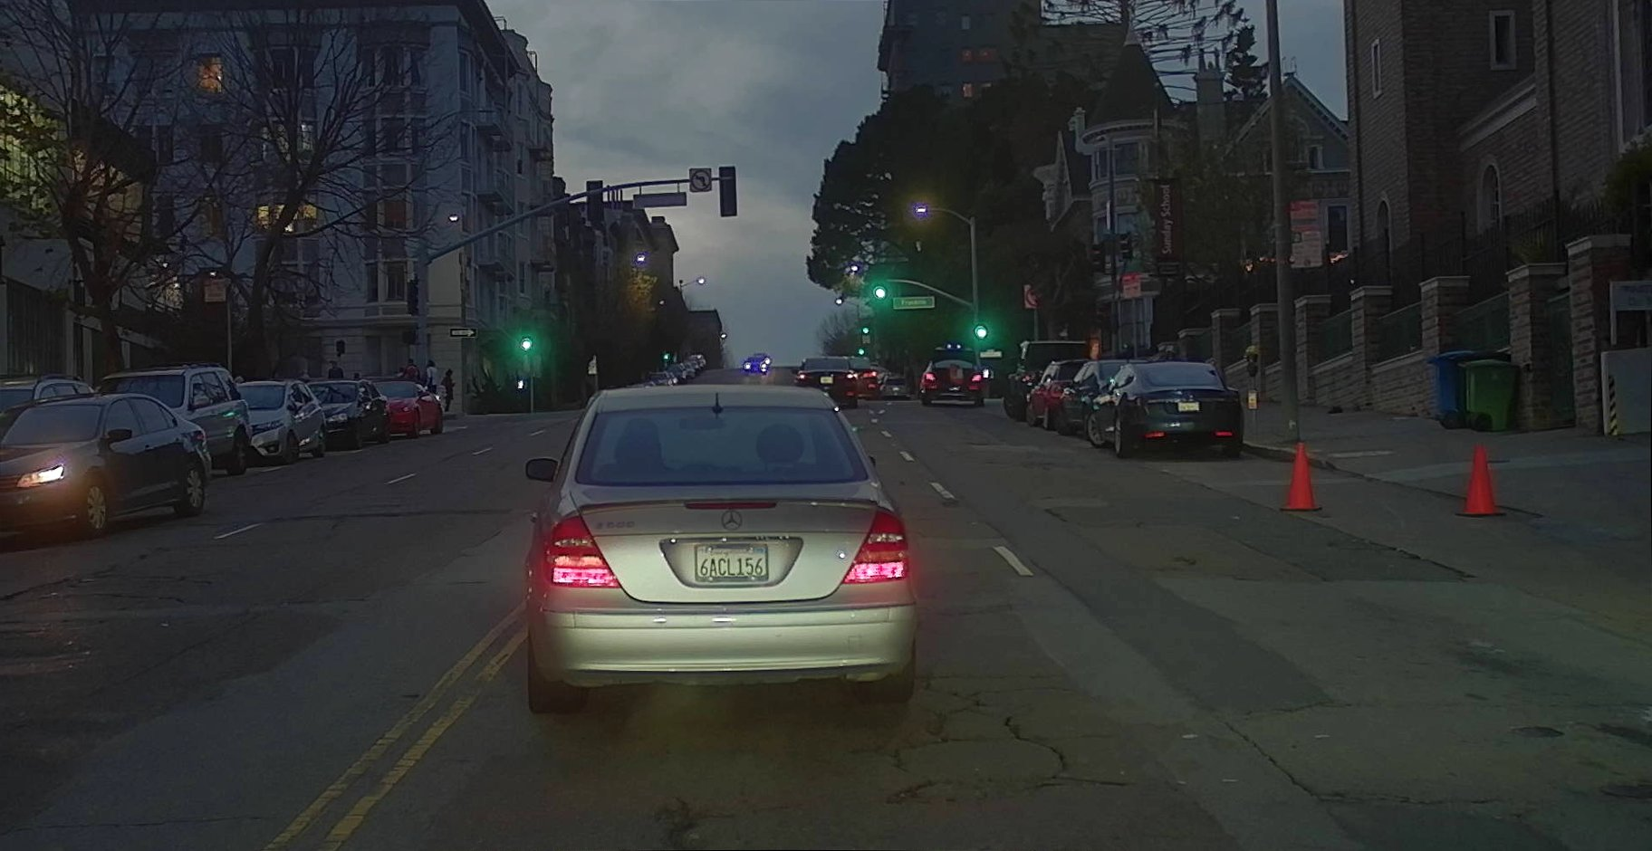
What’s Ground Truth?
Literally, the truth of what’s on the ground.
Let’s peek at what the cars see…
Camera:

Slide 23
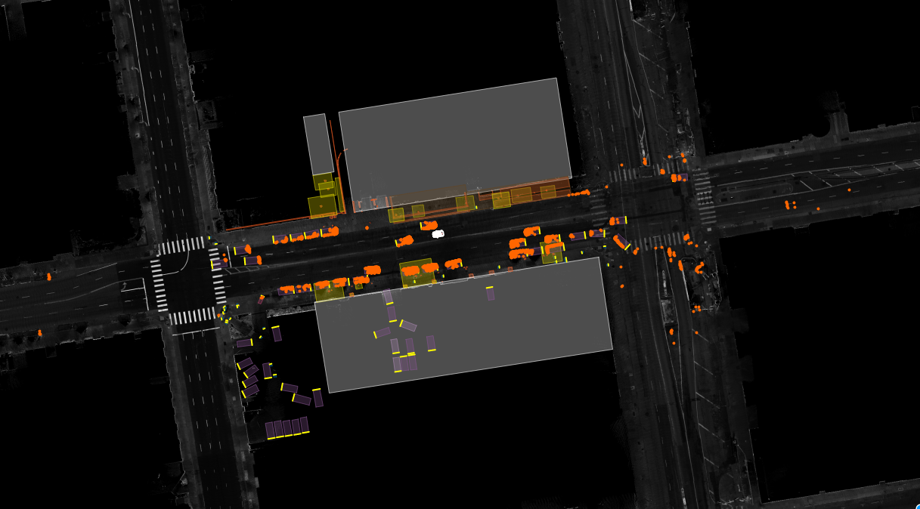
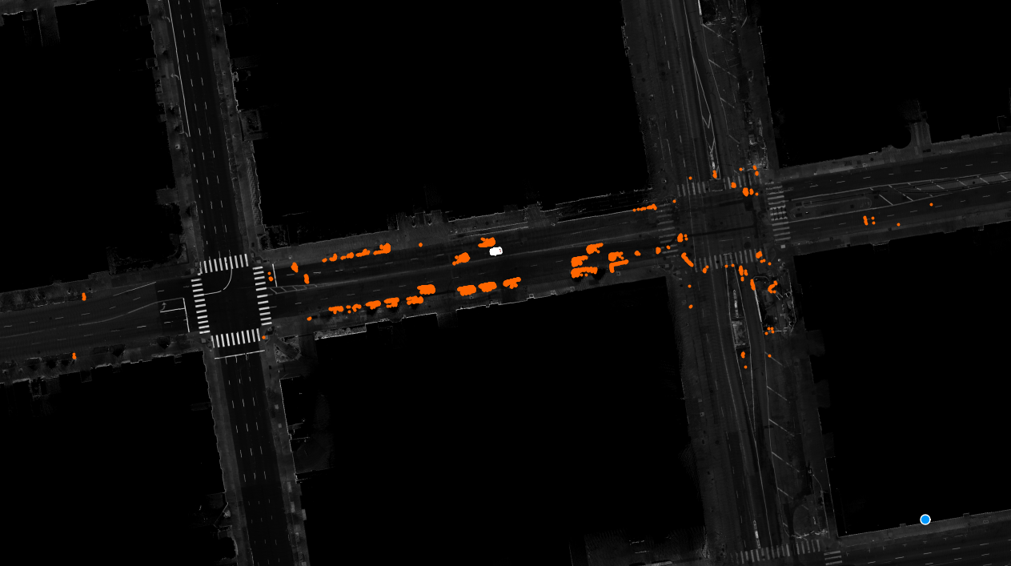
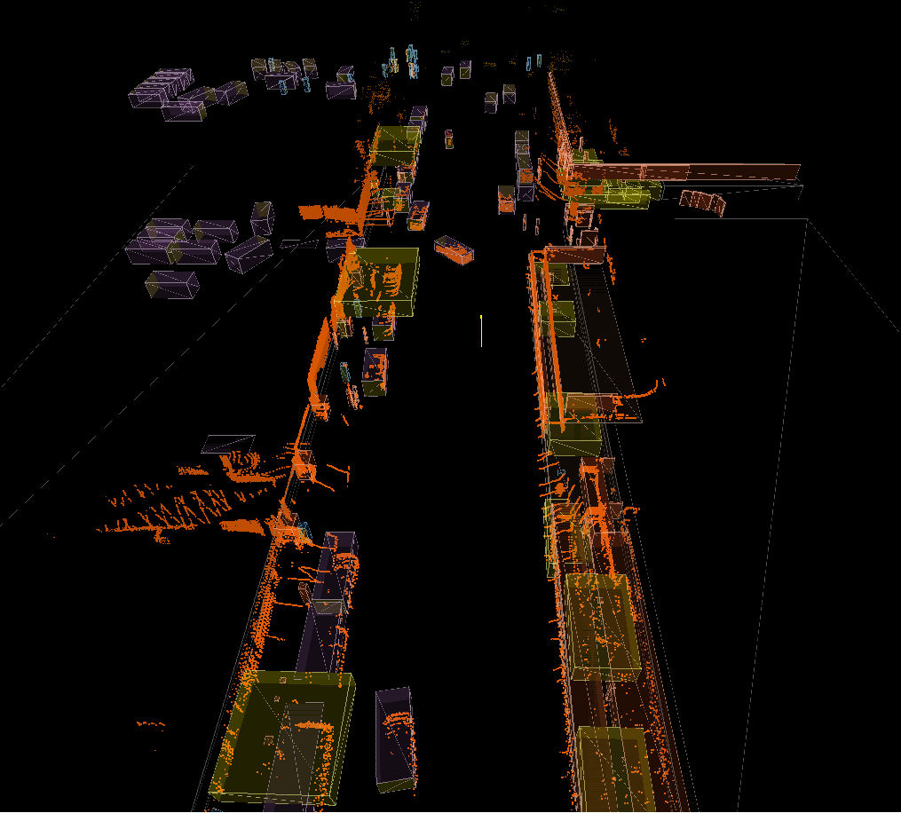

Slide 24
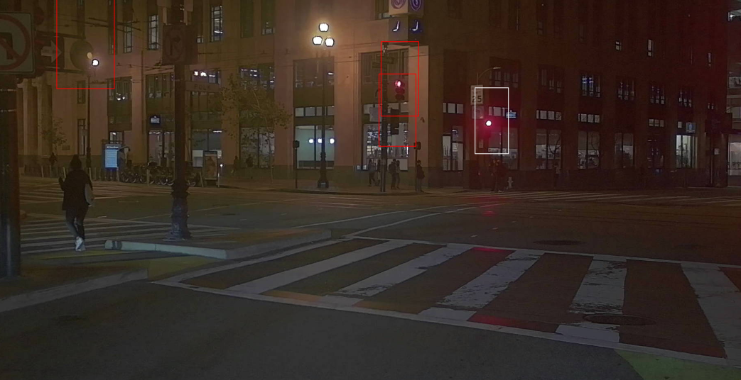
Tools
Types of Labeling
Sensors
Clustering
Which points in this blob make up the shape of this thing?
Segmentation
Label all of this thing in the image/video
What’s the shape and orientation?
Classification
Does this thing exist in the image? Or what is this thing?
LiDAR
Light Detection and Ranging
Point clouds!
Everybody is a blob.
Radar
Radio Detection and Ranging
Arrows!
Camera
Photos!
Traffic lights, pedestrians, etc.
Everybody is a blur.

Slide 25
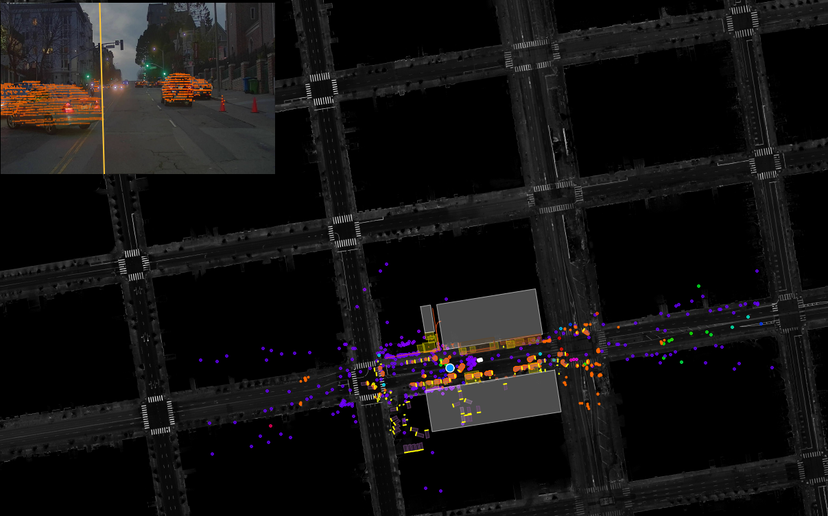

Slide 26
Teams/Pods in Ground Truth
Engineering
Other
Point Cloud (“PoClo”)
Technical Program Manager (TPM)
Hollywood
Product Manager - Technical (PMT)
Data Foundation
Operations
Platform
Point Cloud
REC (Ride Event Classification)
Hollywood
Automation
Growth
Notes:
TPM = plan out what features needs to get done and how/when, across teams - more feature-based
PMT = “what” and “why” of requirements and making sure the right things are being built, planning out timelines - more team-based
Growth ops = works with 3rd party vendors and data/analytics

Slide 27
Stack (Technologies)
Front-End
Back-End
React
Go
Redux
Python
Immutable.js
Postgres & S3
Flow
Docker
Three.js
AWS
Openlayers/WebGL
Google Cloud Platform - coming soon!

Slide 28
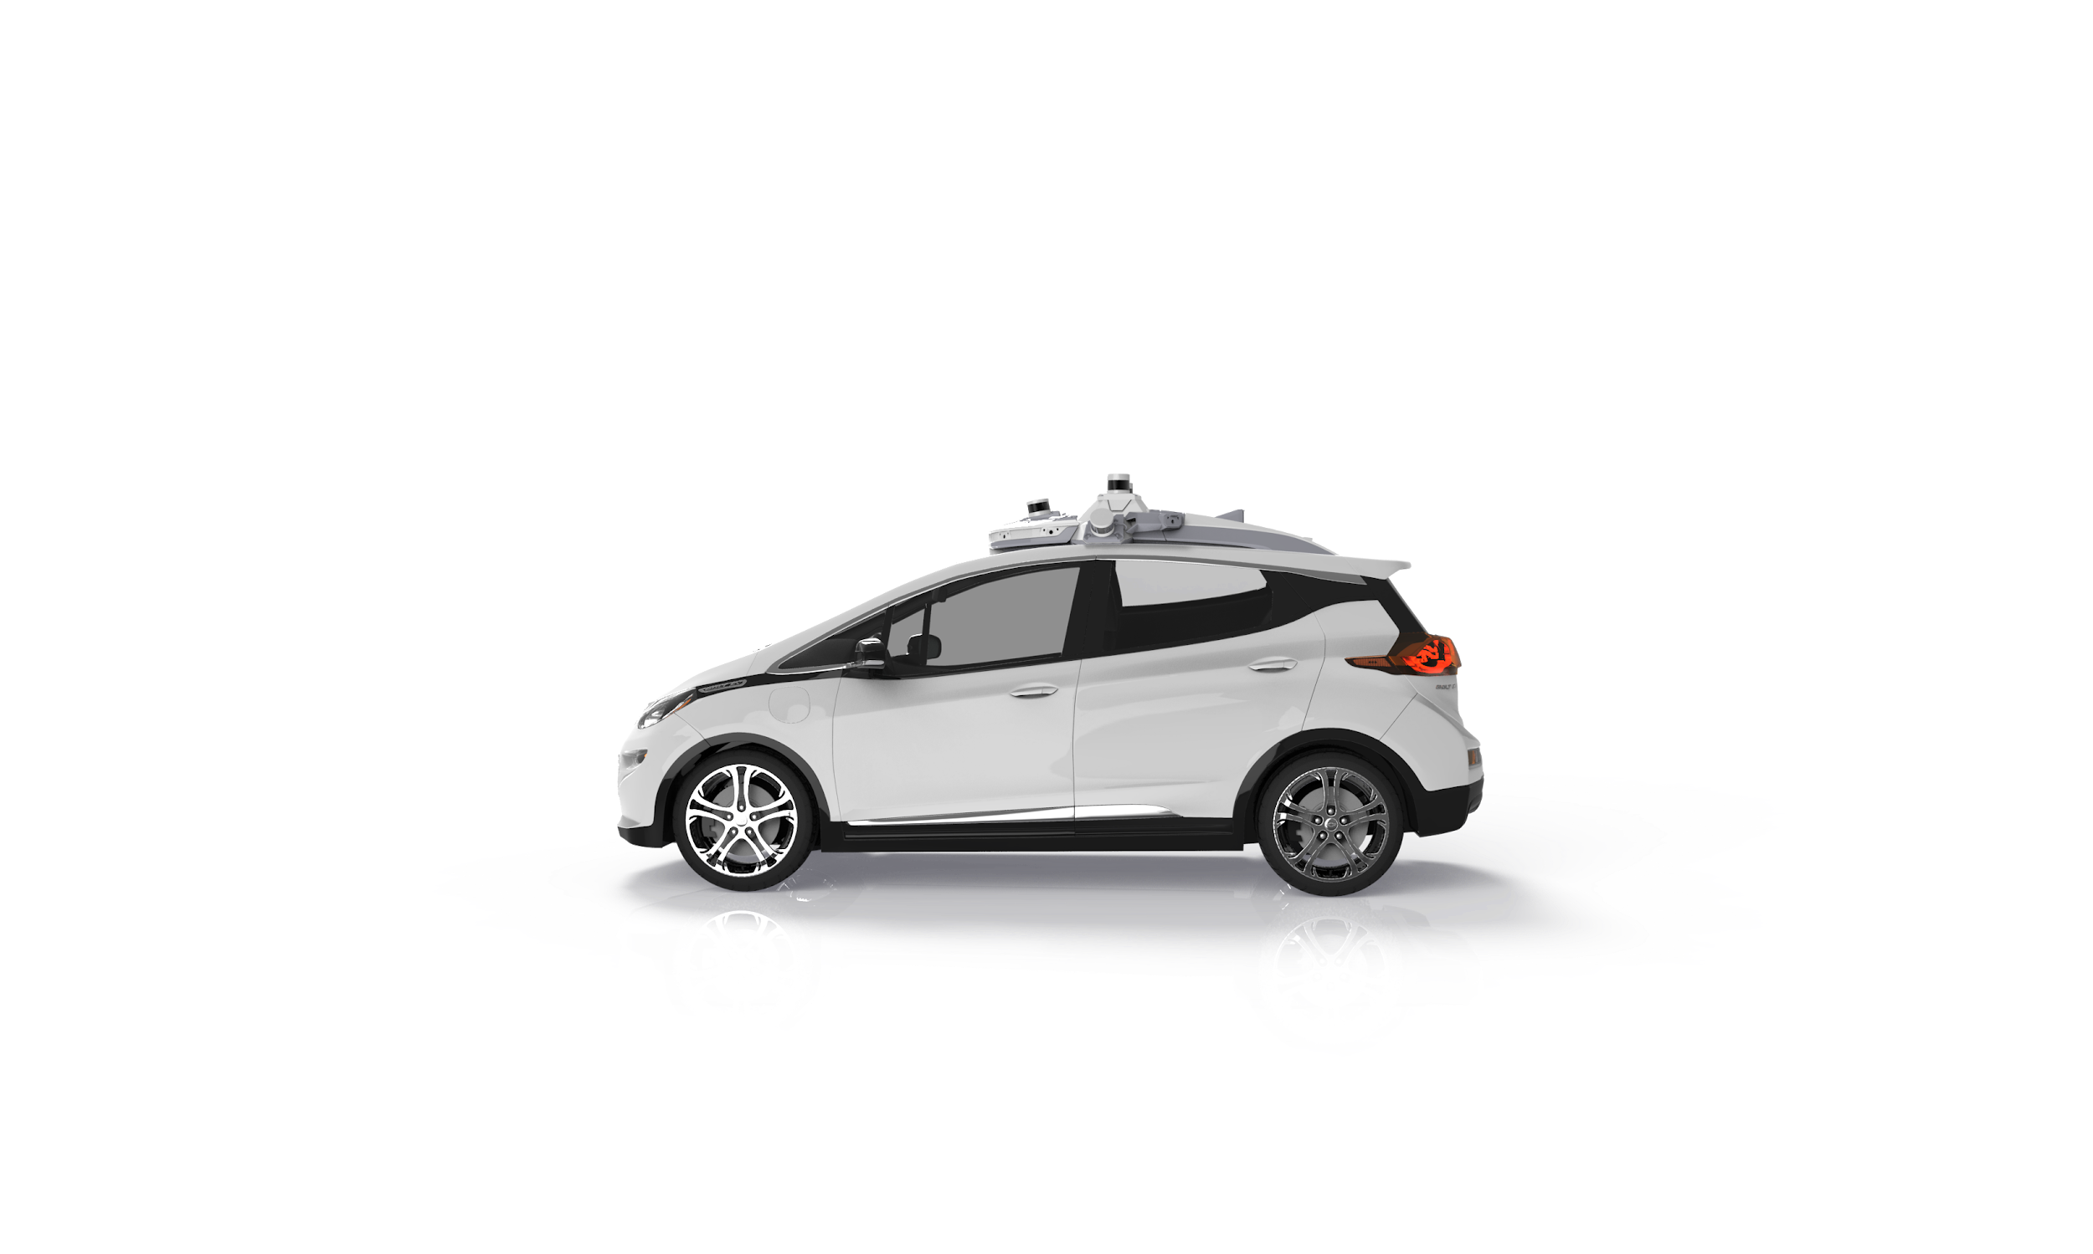




Why Cruise? Why Do I Love Cruise?
Self-driving cars.
It’s THE FUTURE.
Ride free in a self-driving car and make your friends jealous!
Delicious lunch and huge snack selection!
Cool projects
YOUR work is going to contribute to self-driving cars!
We’ve had a Waterloo intern for the past few months on Data Foundation
Cool, smart coworkers and awesome culture!
Memes and bubble tea (“boba”) and Super Smash Brothers
San Francisco is amazing
Pretty good weather: 45 - 85 °F (7 - 29 °C) in San Francisco year-round and no snow
Tons of food, hiking, Silicon Valley, Lake Tahoe, Napa
Notes:
Car crash day of offer letter
Lunch menu
Snack selection rotates monthly
Work with all the technologies listed on previous slides

Slide 29
Questions?
Ask me anything afterwards!

Slide 30
Data @ Cruise
Notes:
Introduction

Slide 31
Groups at Cruise (Engineering)
AV Platform
Building the nerves and muscles of the AV
Ground Truth
Enable our AVs to understand the world
Core Infrastructure
Deploy highly scalable systems
Mapping
Enable our AVs to navigate the world
Data Infrastructure
Enable insights from our extensive data collection
ML Platform
Unlock ML development efficiency to accelerate our development
Data Science
Use our diverse data to improve business and engineering decisions
Product Engineering
Launch the world’s best AV ridesharing service
Engineering Productivity
Build a world-class development environment at Cruise
Remote Assistance
Ensure we are always able to get the AV unstuck

Slide 32
About Me
Software Engineer
Been at Cruise for < 1 year
Data Infrastructure team
MLP Team
Graduated Waterloo ECE in 2018
Guozhen La

Slide 33

AV Data
Notes:
Lot of different data by the AVs (sensor info, time series events published at 1k hz)
Expand that to many scenarios beyond just driving around the block
This very- many variables, just one situation
With data we can take the data and ensure the car can drive in any scenario encountered at Cruise
Example case here with takeover- why? Depending on the team could be a number of things

Slide 34
The Cruise AV generates thousands of different messages across nodes
There are over 200 nodes in the AV
Communicate through a message bus
Data record node writes to disk
Many files recorded at once
Recorded data can be used to replay what occurred on the AV and debug issues
Node
Node
topic B msg
topic C msg
Data Record Node
Node
Node
topic A msg
topic D msg
ROS Messages
SSD
Files (topics C, D)
Files (topics A, B)
Notes:
Different teams care for different nodes (use case for QA needing to determine which node), need different types of data, compressed sensor data, hardware diagnostics, motion planning structured data on maneuvers

Slide 35
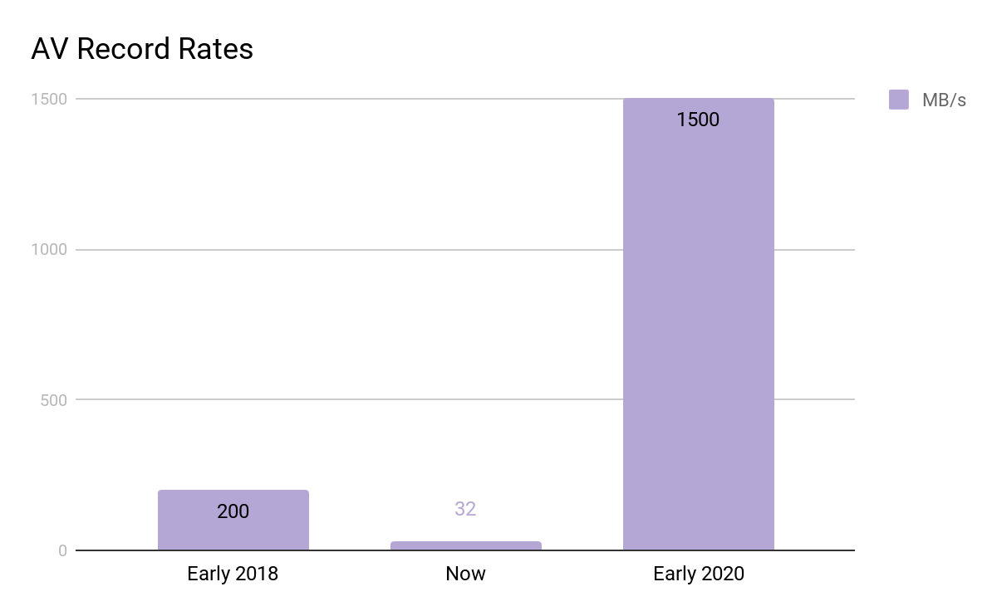
AV Data Record Volumes
Notes:
First AV data record rates, analogy to netflix size (60PB, fbook is > 500 TB/day has 100PB)
200MB/s, 200 TB/d last year
32MB/s, < 100TB/d today due to image compression and selective record
2020 cars, 1.5GB/s, and scaling fleet,
this would mean < 4 AVs constantly running if we wanted to keep with fbook’s rate

Slide 36
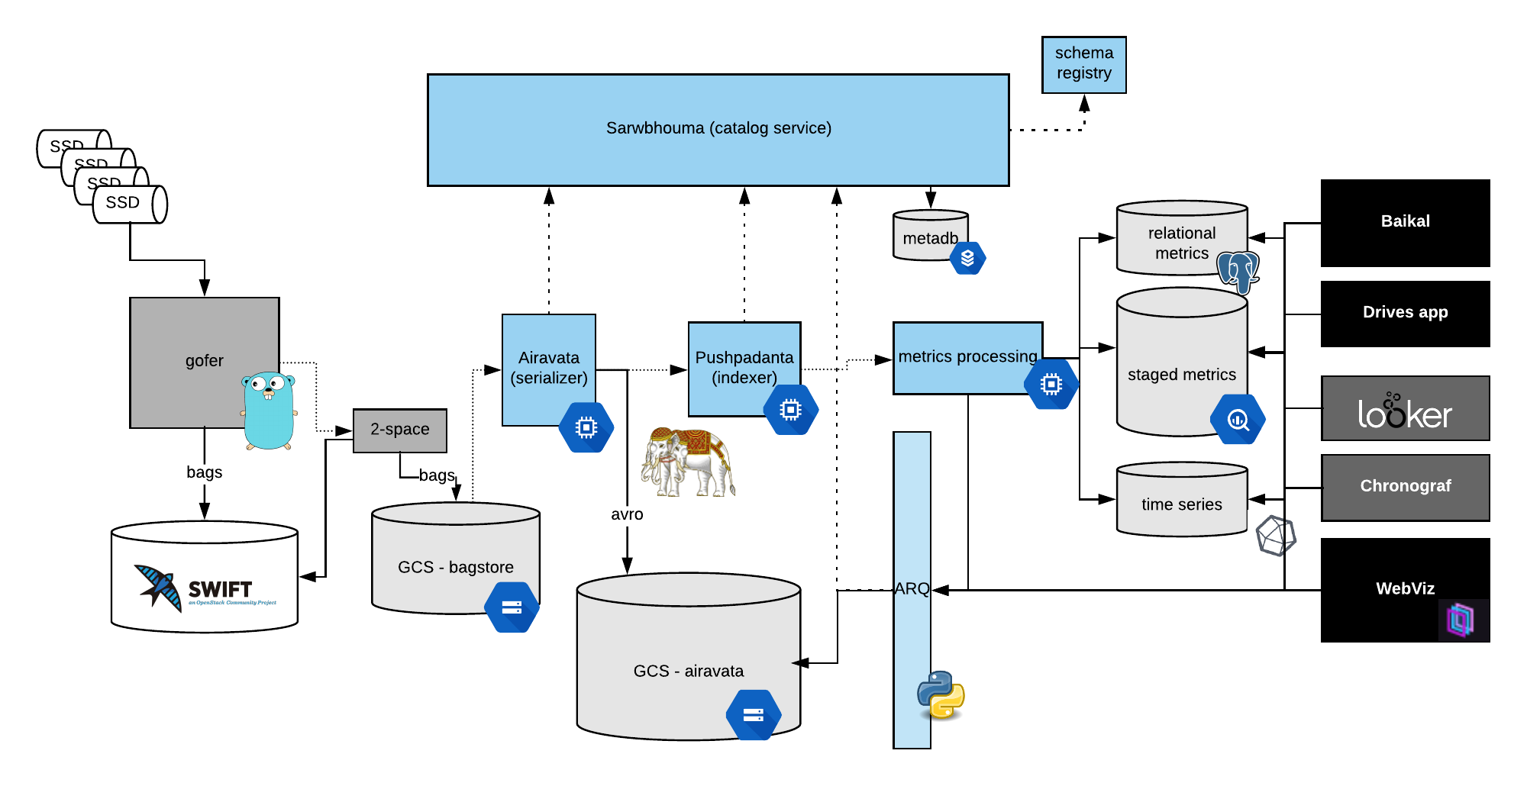
AV Data Pipeline
Notes:
Operators taking hard drives to bagracks in dcs
Gofer rapidly copying data to on-prem
2space sync to cloud, currently moving from AWS to google cloud
First serialize car data from rosbag to avro, store avro files in cloud storage partition by common query params like git branch vin date, index meta info in cloudsql
Processing to pull data into postgres, structured data into BQ, time series into influx
ARQ: python lib to query raw data, used by various AV eng/DS spark jobs
Webviz: viz tool from the video, owned by eng-prod
Chronograf & Looker
Drives app: monolithic webapp, webviz to videos to routes to lunch
Baikal: service w/common query language to query datastores, also query arq

Slide 37
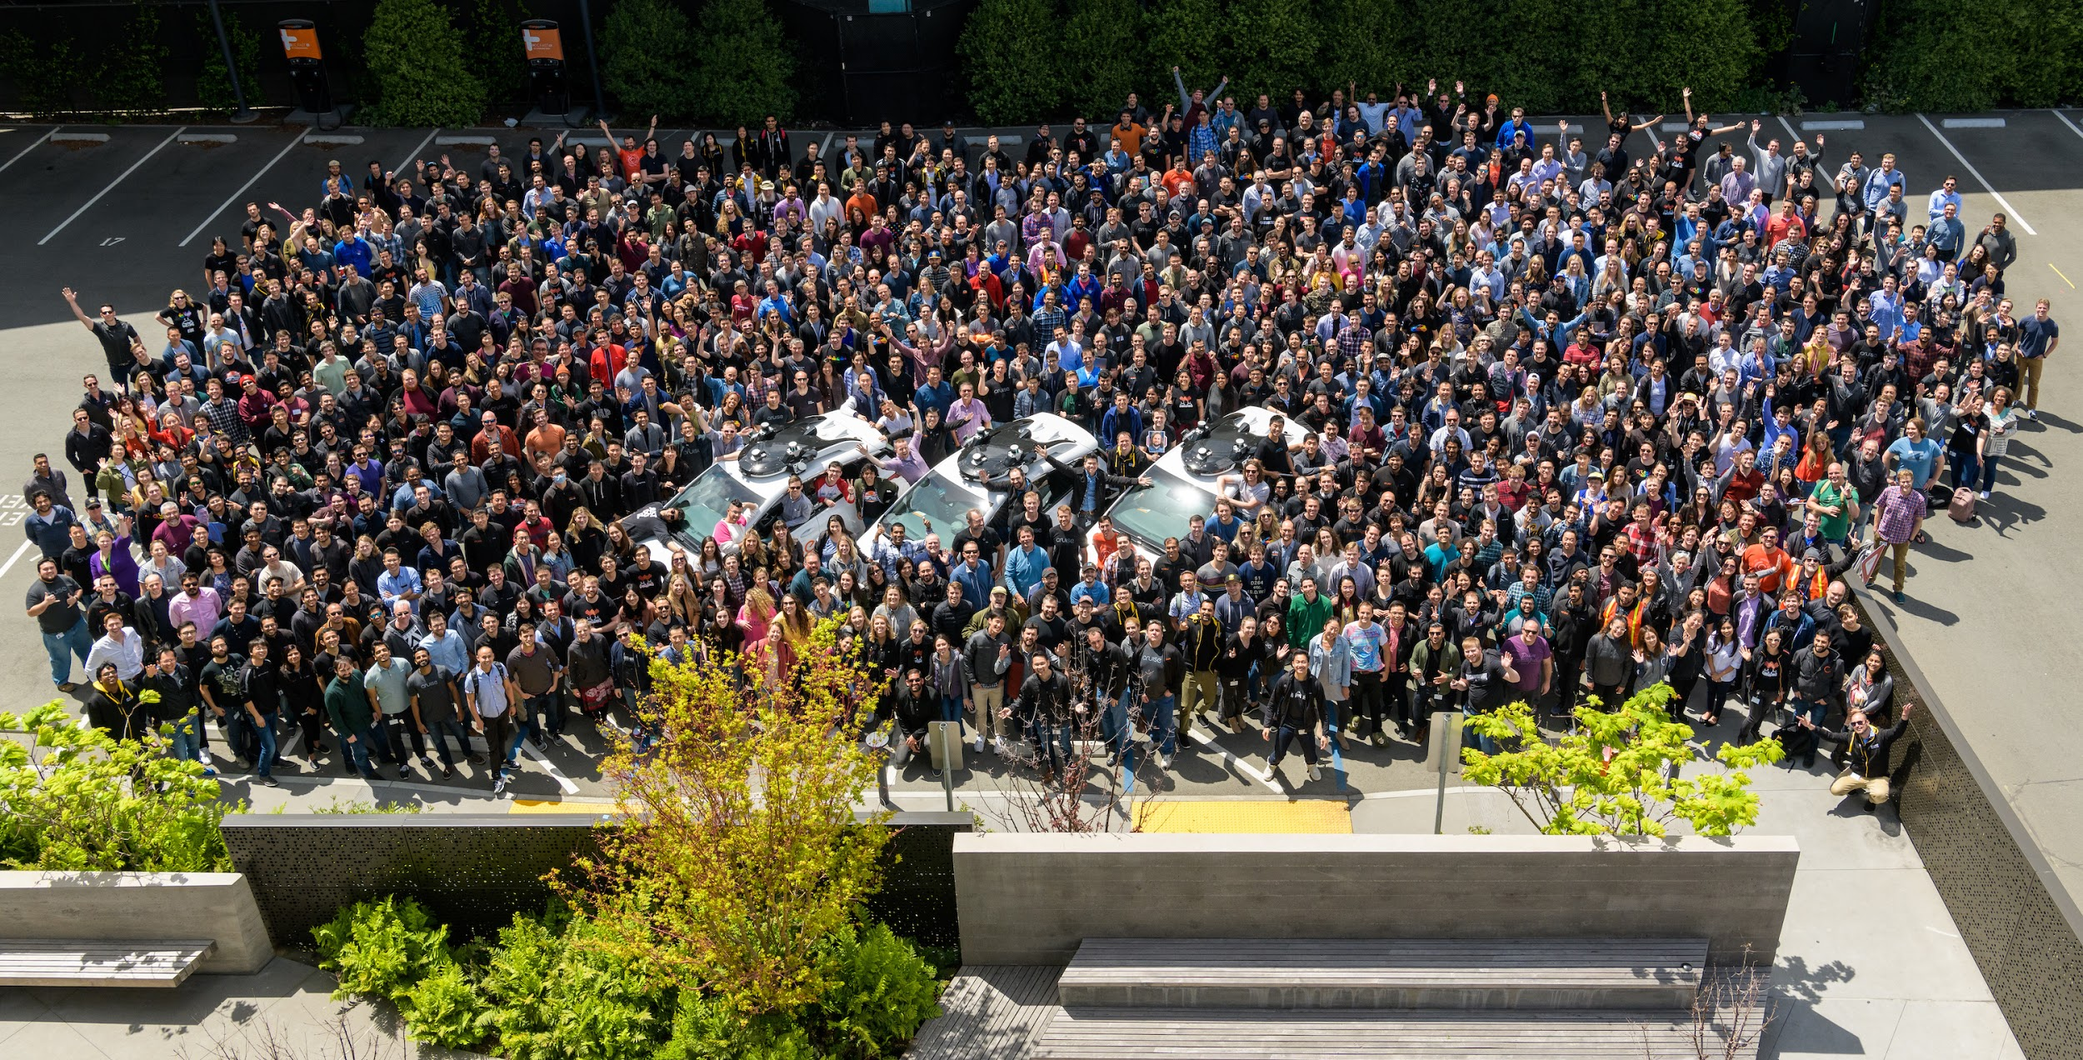
Customers
Notes:
Who do we support? Av eng: Platform, Perception, anything w/ML, P&C, QA, Safety, legal, business, up to executive reports
Most critical data going to focus on: AV data, diverse data

Slide 38
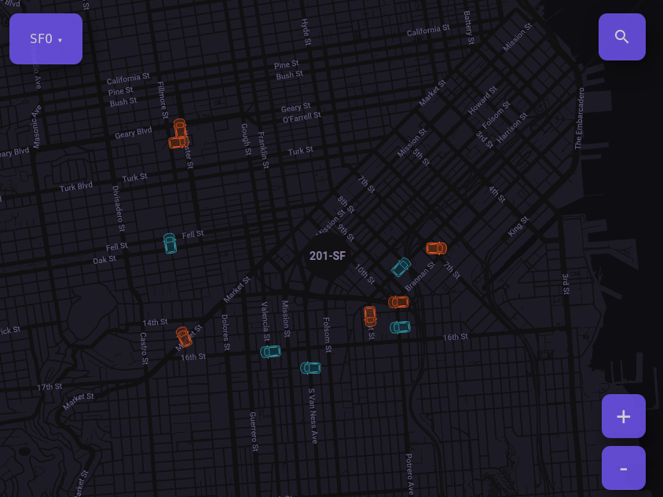
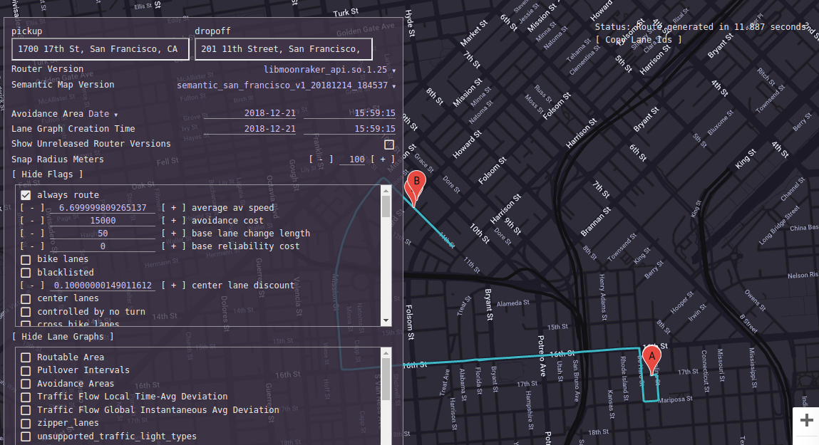
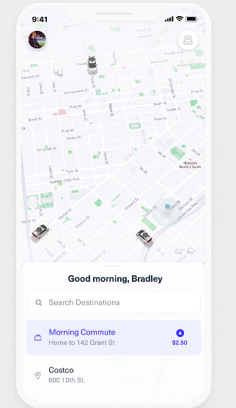
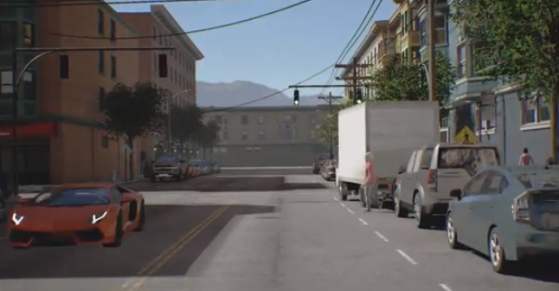
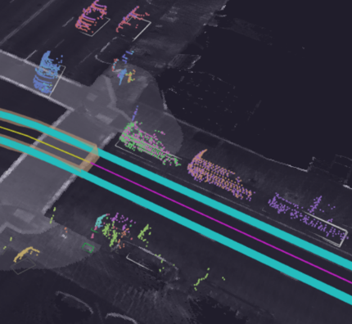
Other data @ Cruise
Fleet management
Simulated/Test
Maps & Routing
Labeled datasets
Ridesharing
Notes:
Just spoke about AV data, much more data to deal with at cruise

Slide 39
Machine Learning Platform
Notes:
Dan and Mo introduce themselves & thank the team for being here

Slide 40
Groups at Cruise (Engineering)
AV Platform
Building the nerves and muscles of the AV
Ground Truth
Enable our AVs to understand the world
Core Infrastructure
Deploy highly scalable systems
Mapping
Enable our AVs to navigate the world
Data Infrastructure
Enable insights from our extensive data collection
ML Platform
Unlock ML development efficiency to accelerate our development
Data Science
Use our diverse data to improve business and engineering decisions
Product Engineering
Launch the world’s best AV ridesharing service
Engineering Productivity
Build a world-class development environment at Cruise
Remote Assistance
Ensure we are always able to get the AV unstuck

Slide 41
Machine-Learning and Autonomous Vehicles
Think about a robot car trying to make a right-turn in a quiet neighborhood
Notes:
Theme of these next few slides are trying to motivate the why of ML being critical for AVs
Notes for the story in the slide:
One might imagine solving this with heuristics
Wait for no oncoming traffic and/or a green light
Wait for pedestrians to exit the cross-walk
This raises questions though:
How are you seeing the oncoming cars/traffic-light/pedestrians?
How are you predicting their trajectories?
What if the situation gets more complicated?

Slide 42
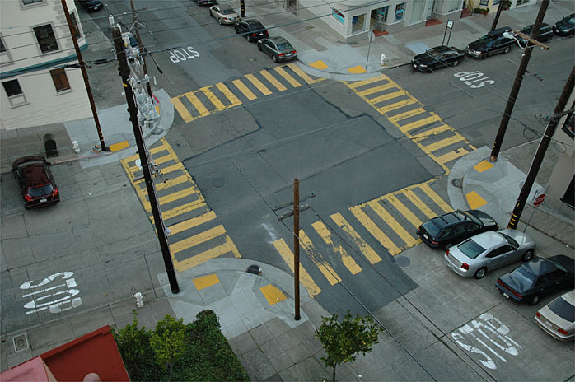
Machine-Learning and Autonomous Vehicles
Think about a robot car trying to make a right-turn in a quiet neighborhood
Notes:
Theme of these next few slides are trying to motivate the why of ML being critical for AVs
Notes for the story in the slide:
One might imagine solving this with heuristics
Wait for no oncoming traffic and/or a green light
Wait for pedestrians to exit the cross-walk
This raises questions though:
How are you seeing the oncoming cars/traffic-light/pedestrians?
How are you predicting their trajectories?
What if the situation gets more complicated?

Slide 43
Machine-Learning and Autonomous Vehicles
Let’s look at some other examples
Can you come up with heuristics to solve, say….

Slide 44
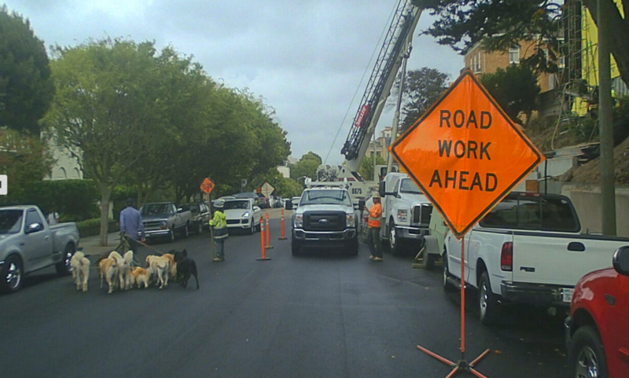
Machine-Learning and Autonomous Vehicles
^ This ^
Notes:
From Kyle’s Medium Post
“A typical day in San Francisco, captured by one of our self-driving cars.”

Slide 45
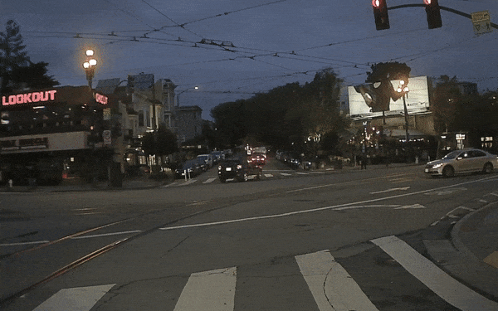
Machine-Learning and Autonomous Vehicles
^ Or this ^
Notes:
From Kyle’s Medium Post
“Traffic lights out at 6-way intersection. All driving completed autonomously.”

Slide 46
Cruise leverages ML across multiple scales
Machine-Learning is a critical component of Cruise’s AV software
Examples include...

Slide 47
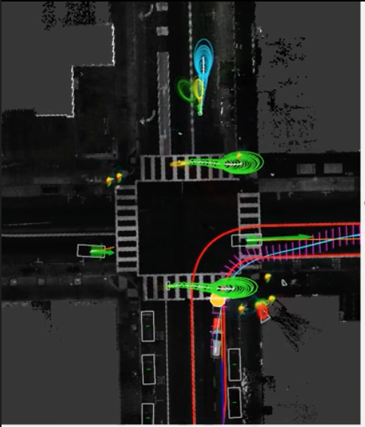
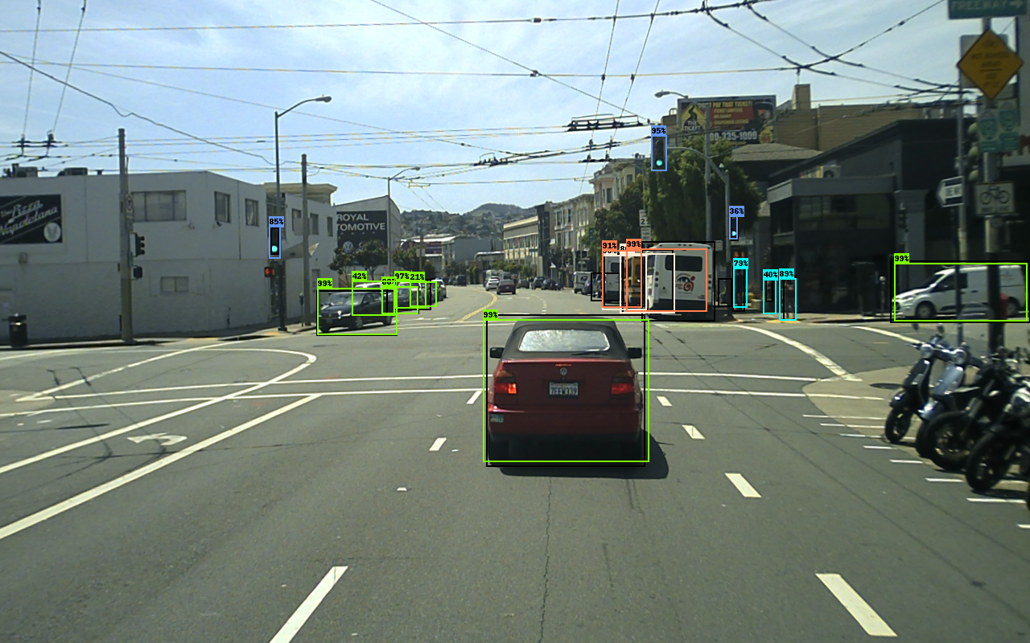
Cruise leverages ML across multiple scales
In our individual AVs
Object Detection
Trajectory Prediction
For our AV Fleets
Routing/ETA
Fleet Dispatch/Management
To support other ML pipelines
ML-driven auto labeling

Slide 48
Cruise leverages ML across multiple scales
In our individual AVs
Object Detection
Trajectory Prediction
For our AV Fleets
Routing/ETA
Fleet Dispatch/Management
To support other ML pipelines
ML-driven auto labeling

Slide 49
Cruise leverages ML across multiple scales
In our individual AVs
Object Detection
Trajectory Prediction
For our AV Fleets
Routing/ETA
Fleet Dispatch/Management
To support other ML pipelines
ML-driven auto labeling
Notes:
Image from Mothra Design Doc

Slide 50
Cruise leverages ML across multiple scales
In our individual AVs
Object Detection
Trajectory Prediction
For our AV Fleets
Routing/ETA
Fleet Dispatch/Management
To support other ML pipelines
ML-driven auto labeling
And many more!
Notes:
AV (object detection, trajectory prediction, ...), ride hail (demand forecasting, vehicle resource management, ...), self-learning systems (auto data discovery, adaptive learning, hyperparameter optimization, ...), customer support, fleet management, strategic decision making and more

Slide 51
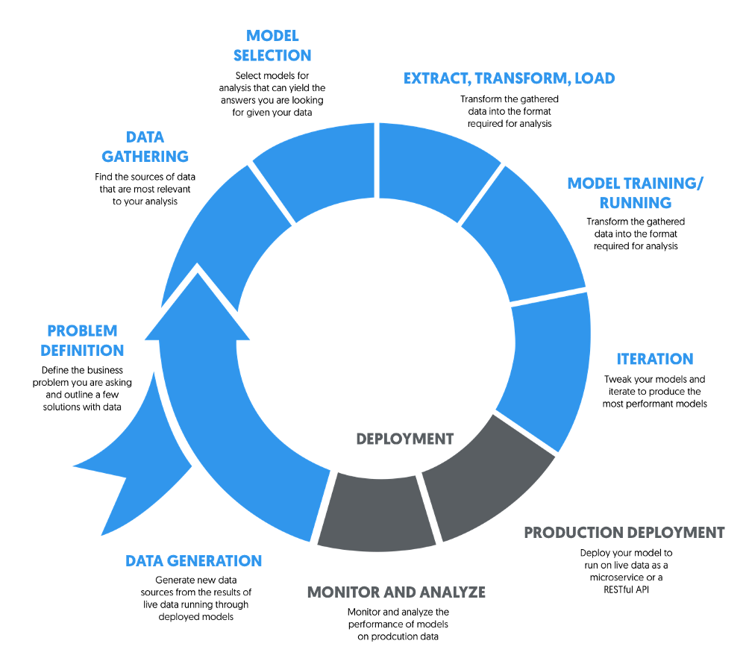
ML-DevOps differs from “traditional” SW-DevOps
ML-DevOps: “Data is your lifeblood”
Notes:
Data is your lifeblood
Identifying what to work on
Training ML models
Post-deployment validation
Fortunately, at Cruise, we have plenty of data (4 TB / hr / car)

Slide 52
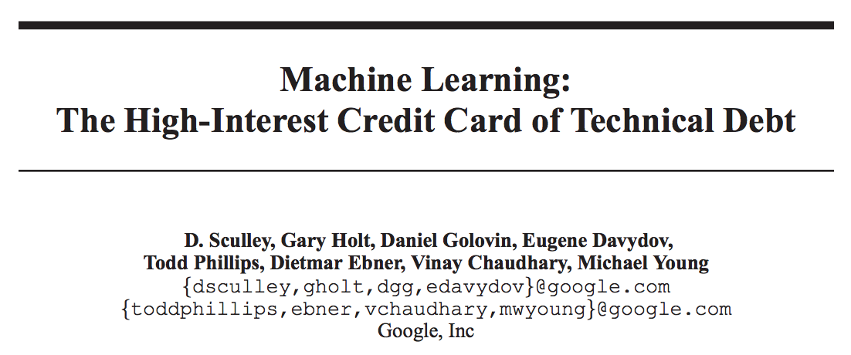
ML-DevOps differs from “traditional” SW-DevOps
ML systems have an increased risk of technical debt
Entanglement
Data Dependencies
Visibility Debt (Undeclared Consumers)
Lack of common frameworks => Lots of Glue Code
Notes:
In a traditional IT system
The behavior is defined by code
This behavior is validated with unit tests
In ML systems
The behavior is defined by data

Slide 53
ML Platforms in Industry
Dedicated ML-Platforms are a nascent but
critical component of modern day SW companies
Examples:
Michelangelo (Uber)
FBFlow (Facebook)
TFX (Google)
Bighead (AirBnB)
Notes:
In a traditional IT system
The behavior is defined by code
This behavior is validated with unit tests
In ML systems
The behavior is defined by data

Slide 54
ML Platform @ Cruise
Empower machine learning teams at Cruise to efficiently experiment, frequently deploy and safely accelerate our development.

Slide 55



Machine Learning Platform @ Cruise
Three Core Product Areas
Data Preparation
Training
Deployment
Discover data and prepare datasets
Experiment and learn quickly
Deploy to the cloud or car
Notes:
In a traditional IT system
The behavior is defined by code
This behavior is validated with unit tests
In ML systems
The behavior is defined by data

Slide 56
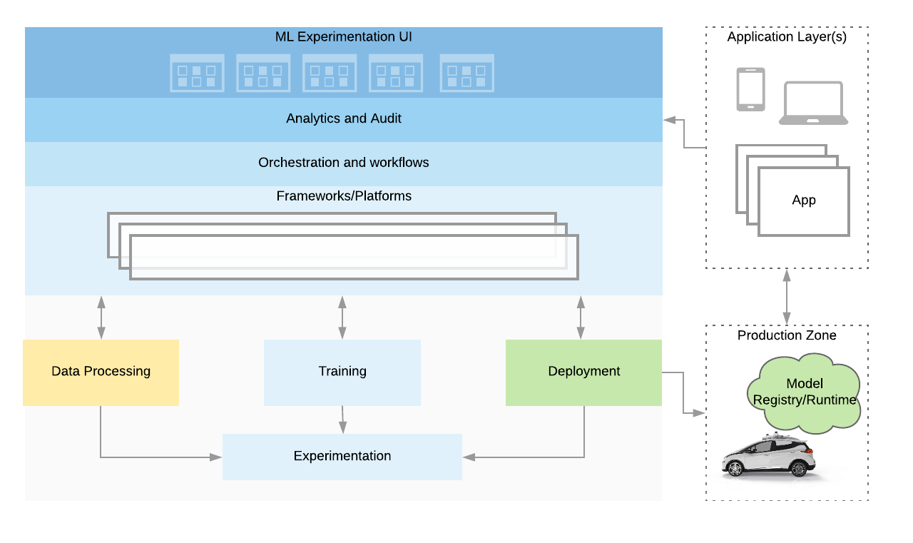
Machine Learning Platform @ Cruise
Notes:
Three core product areas
Data Processing
Model Training/Experimentation
Model Production Deployment

Slide 57
Product Engineering

Slide 58
About Me
Joined Cruise Sept 2018
Full-stack software engineer
Product Engineering - Rideshare Backend
MIT BS 2015, MS 2018
New to the SF Bay Area
Teresa Lin

Slide 59
Groups at Cruise (Engineering)
AV Platform
Building the nerves and muscles of the AV
Ground Truth
Enable our AVs to understand the world
Core Infrastructure
Deploy highly scalable systems
Mapping
Enable our AVs to navigate the world
Data Infrastructure
Enable insights from our extensive data collection
ML Platform
Unlock ML development efficiency to accelerate our development
Data Science
Use our diverse data to improve business and engineering decisions
Product Engineering
Launch the world’s best AV ridesharing service
Engineering Productivity
Build a world-class development environment at Cruise
Remote Assistance
Ensure we are always able to get the AV unstuck

Slide 60
Teams in Product Engineering
Mobile (iOS, Android)
In-Car Experience (Tablet)
Dispatch
Simulation Test Creation
Fleet Maintenance
Mapping

Slide 61
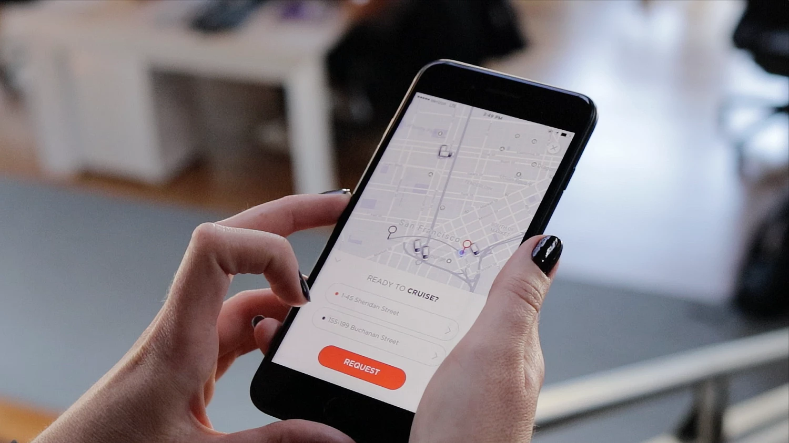

Slide 62

Rideshare
Mobile (iOS, Android), In-Car Experience, Dispatch
Connect customers with Cruise, by delivering an efficient, easy to use, and empowering
autonomous ride-hailing experience

Slide 63
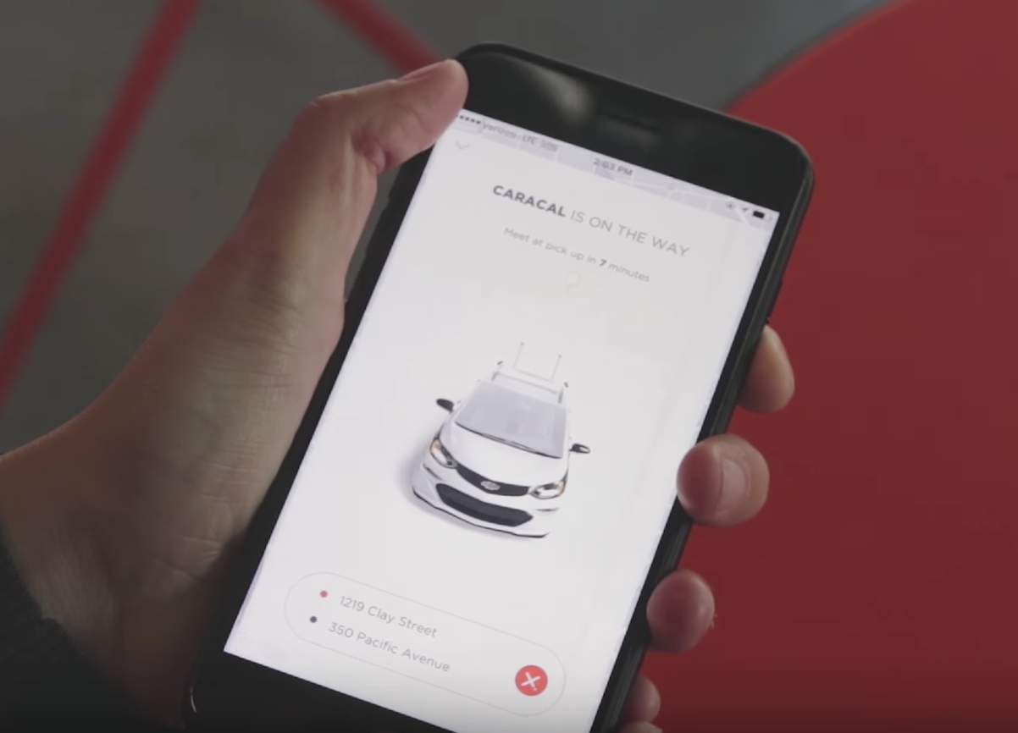
Rideshare
Mobile (iOS, Android), In-Car Experience, Dispatch
Continually updates route to most efficient one known
Familiar ridesharing interface
Detailed user experience testing*
Designing for accessibility*
Notes:
accessibility:
3 teams: public affairs, UX research, Product Design
visually impaired users need to use multiple apps -- how to design so that they can easily navigate to the car, know that they are getting into the right car, and feel safe when they are in the car?

Slide 64
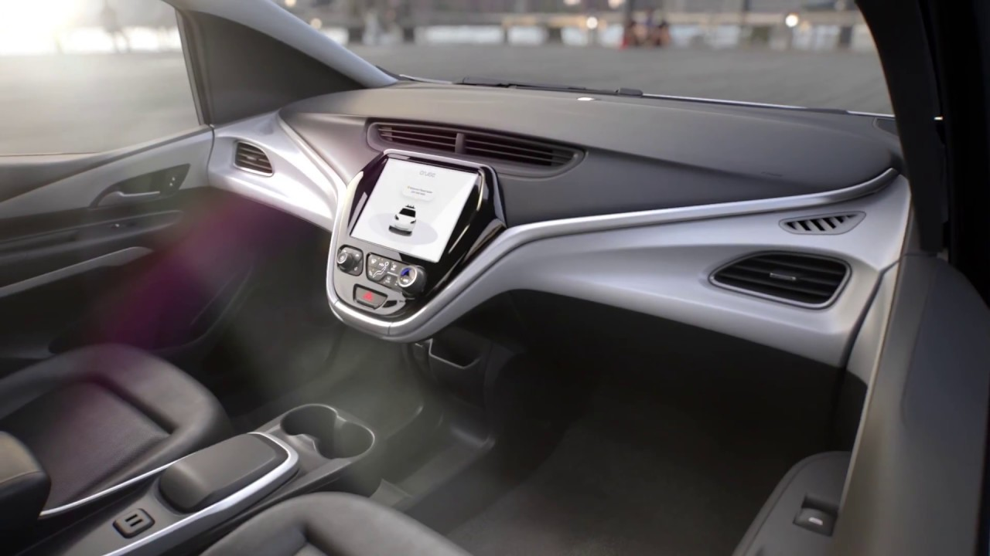
Rideshare
Mobile (iOS, Android), In-Car Experience, Dispatch
Safety is #1!
User unlocks doors
Pullovers anytime
In-car tablet
Customer support
Remote assistance*

Slide 65
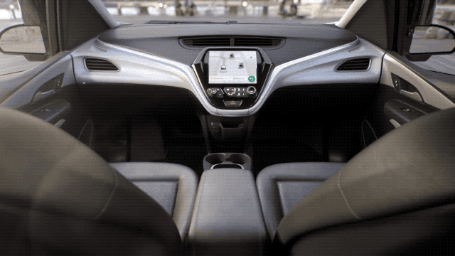
Rideshare
Mobile (iOS, Android), In-Car Experience, Dispatch
Safety, Comfort
Conveys what car sees
Allows trip modifications and ride adjustments
Integrated customer support
Notes:
ride adjustments: radio, HVAC

Slide 66
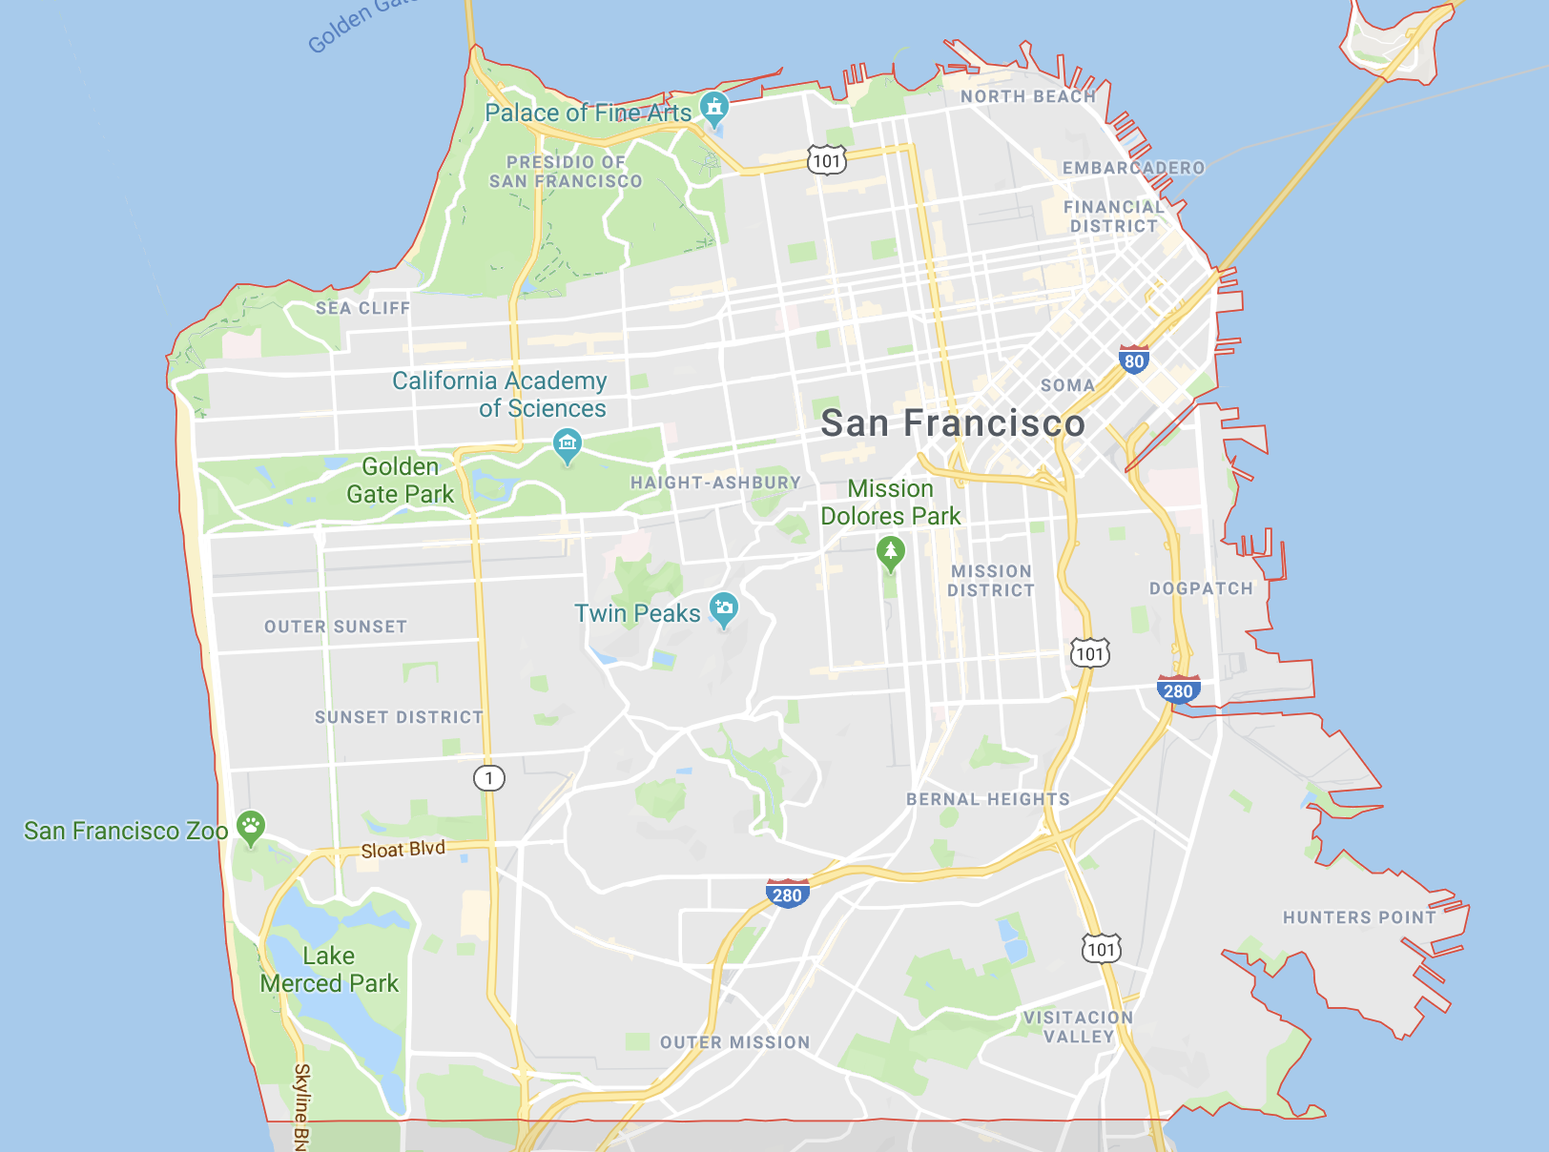
Rideshare
Mobile (iOS, Android), In-Car Experience, Dispatch
How do you route cars all over SF?
Use data science models to position vehicles ideally for next trip
Router on car is loaded with map of drivable area, lane information, etc.
Router determines points en-route to destination
Notes:
100+ cars!

Slide 67
Rideshare
Mobile (iOS, Android), In-Car Experience, Dispatch
How do you track cars all over SF?
Vehicles send information about current location, trip, etc
Router in the cloud takes in map versions and vehicle information & determines where the vehicle will go next, ETA, etc.
Cache map versions for faster lookup
Notes:
router runs multiple map version simultaneously
predictions must be accurate because the data from the router in the cloud is saved and sent to mobile

Slide 68
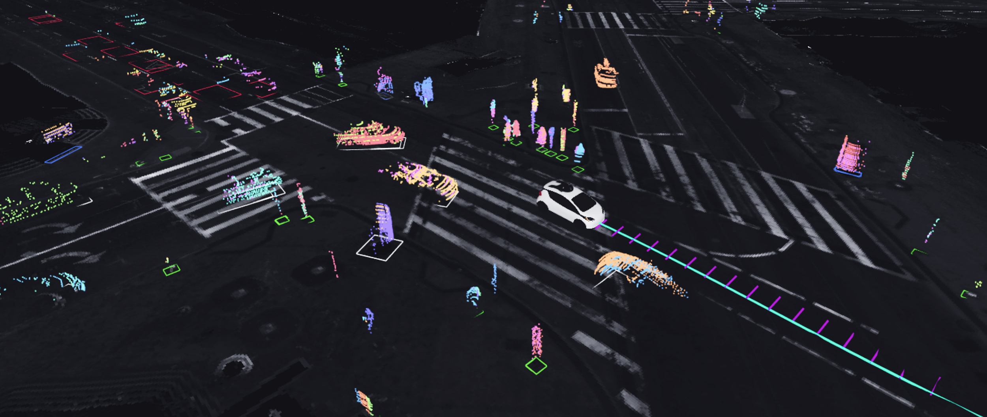

Slide 69
Regression Testing
How do you test changes to AV software?
Do you take a ride.. ?
How do you know if your change worked?
What if your change broke 100000 other features??

Slide 70
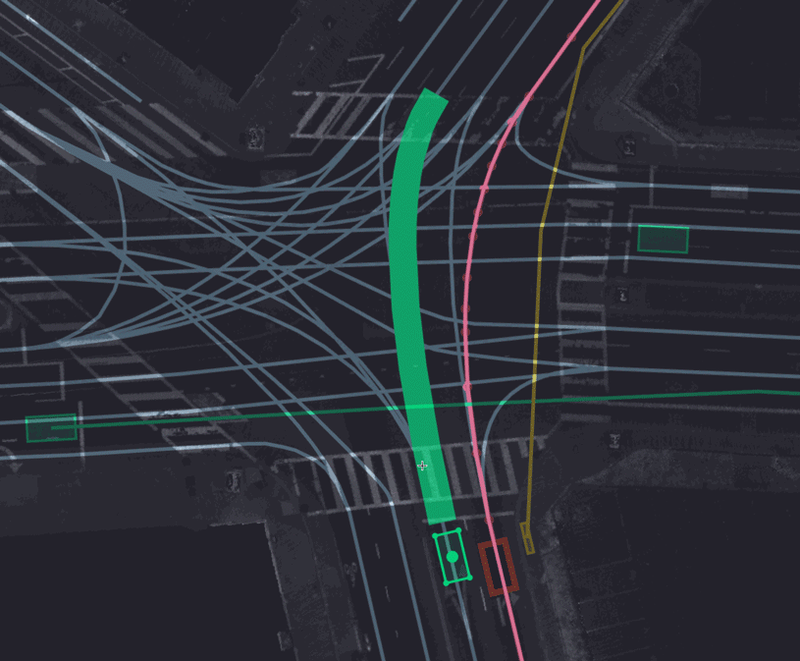
Expediting Simulation Test Creation
Simulation Test Creation
Sim tests are run on files specifying a “scenario”
Build and maintain a GUI that speeds up scenario generation for QA
Exports the scenario as necessary file for 2D sim tests
Notes:
scenario: lane info, traffic lights, other actors on the road, dpvs, etc.
speeds up software regression testing!

Slide 71
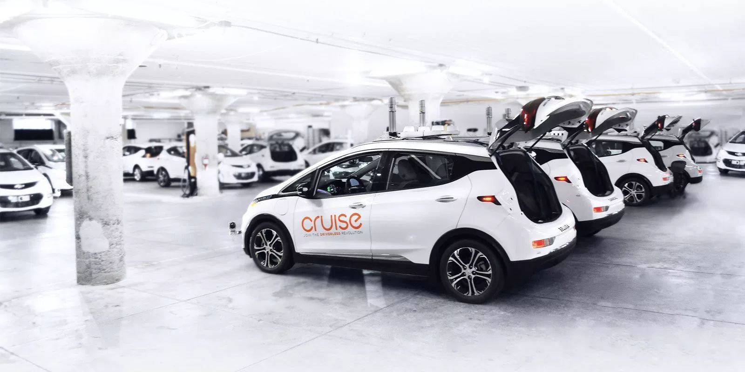

Slide 72
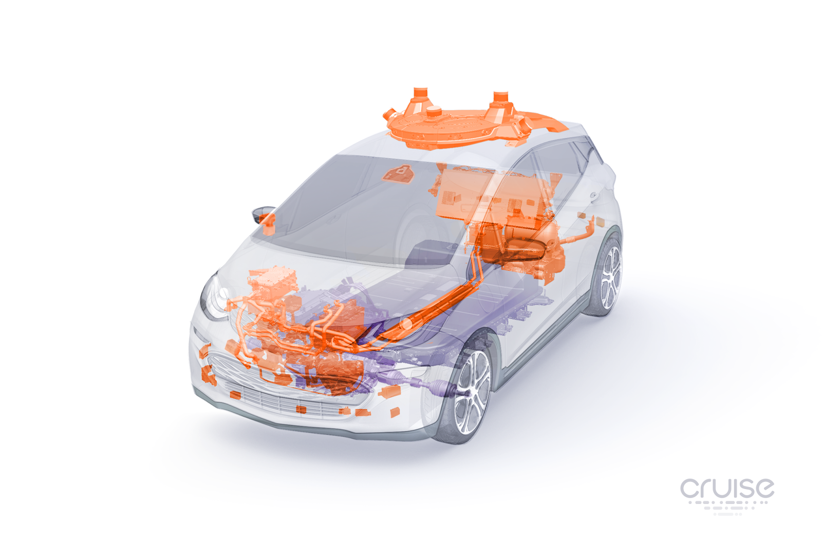
Lidar
High-precision laser sensors that detect fixed and moving objects
Cameras
Detect and track pedestrians/ cyclists, traffic lights, free space and other features
Articulating radars
Detect moving vehicles at long range over a wide field of view
Short-range radars
Detect objects around the vehicle
Long-range radars
Detect vehicles and measure velocity

Slide 73
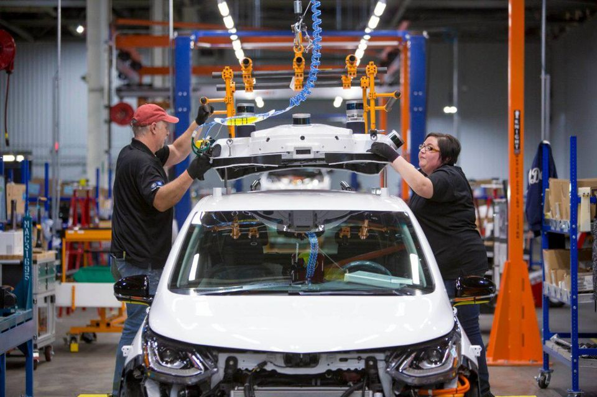
Maintenance and Fleet Operations
Fleet Maintenance
100+ vehicles of different..
Model
Tracking numbers
Hardware profile
Software profile
Use case
Status
Operational region
...and more!
Notes:
hardware profile: sensors, hw components, batteries, etc.
software profile: what version of the software stack is running, what version of apps are running, etc.

Slide 74
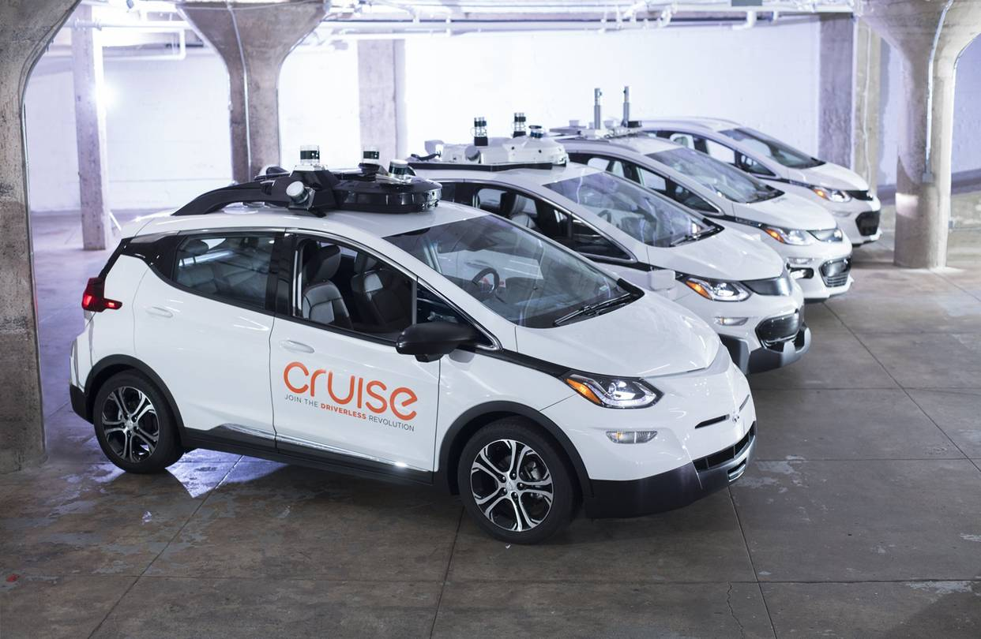
Maintenance and Fleet Operations
Fleet Maintenance
Engineers need to run tests on-car
Operators need to build software stack onto cars quickly
As number of cars scales, so must processes to maintain cars and engineering

Slide 75
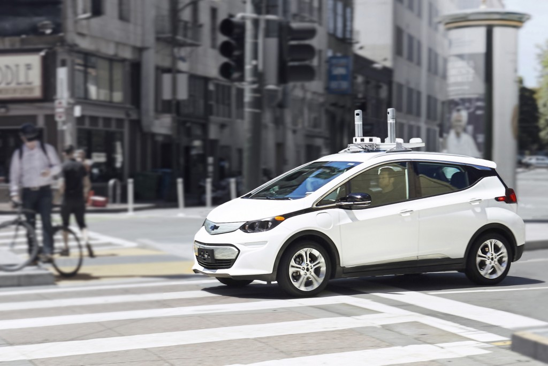

Slide 76
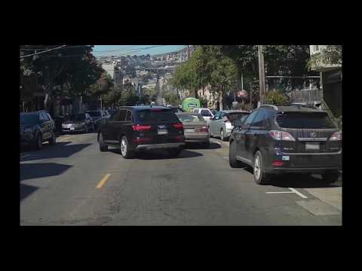
Characterizing SF
Mapping
Driving in SF is hard!
One-way streets
Tram and bus only lanes
Do not park lanes
Placement of traffic lights
Double parked vehicles
Pedestrians
Cyclists
etc, etc, etc!

Slide 77
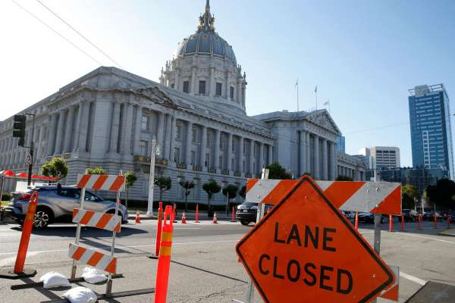
Characterizing SF
Mapping
Vehicles specifically assigned to map SF
Important to track map releases, areas to re-map, etc.
Downstream customers rely on accurate and existent maps

Slide 78

Why I Work at Cruise
Impact, impact, impact!
Challenging problems
Fast turnarounds
Lots of ownership
Work with amazing people!
Values ground us
Communities within Cruise
Cool perks!
Take rides in Cruise cars
Company wide demos
Snacks!

